Slide 1
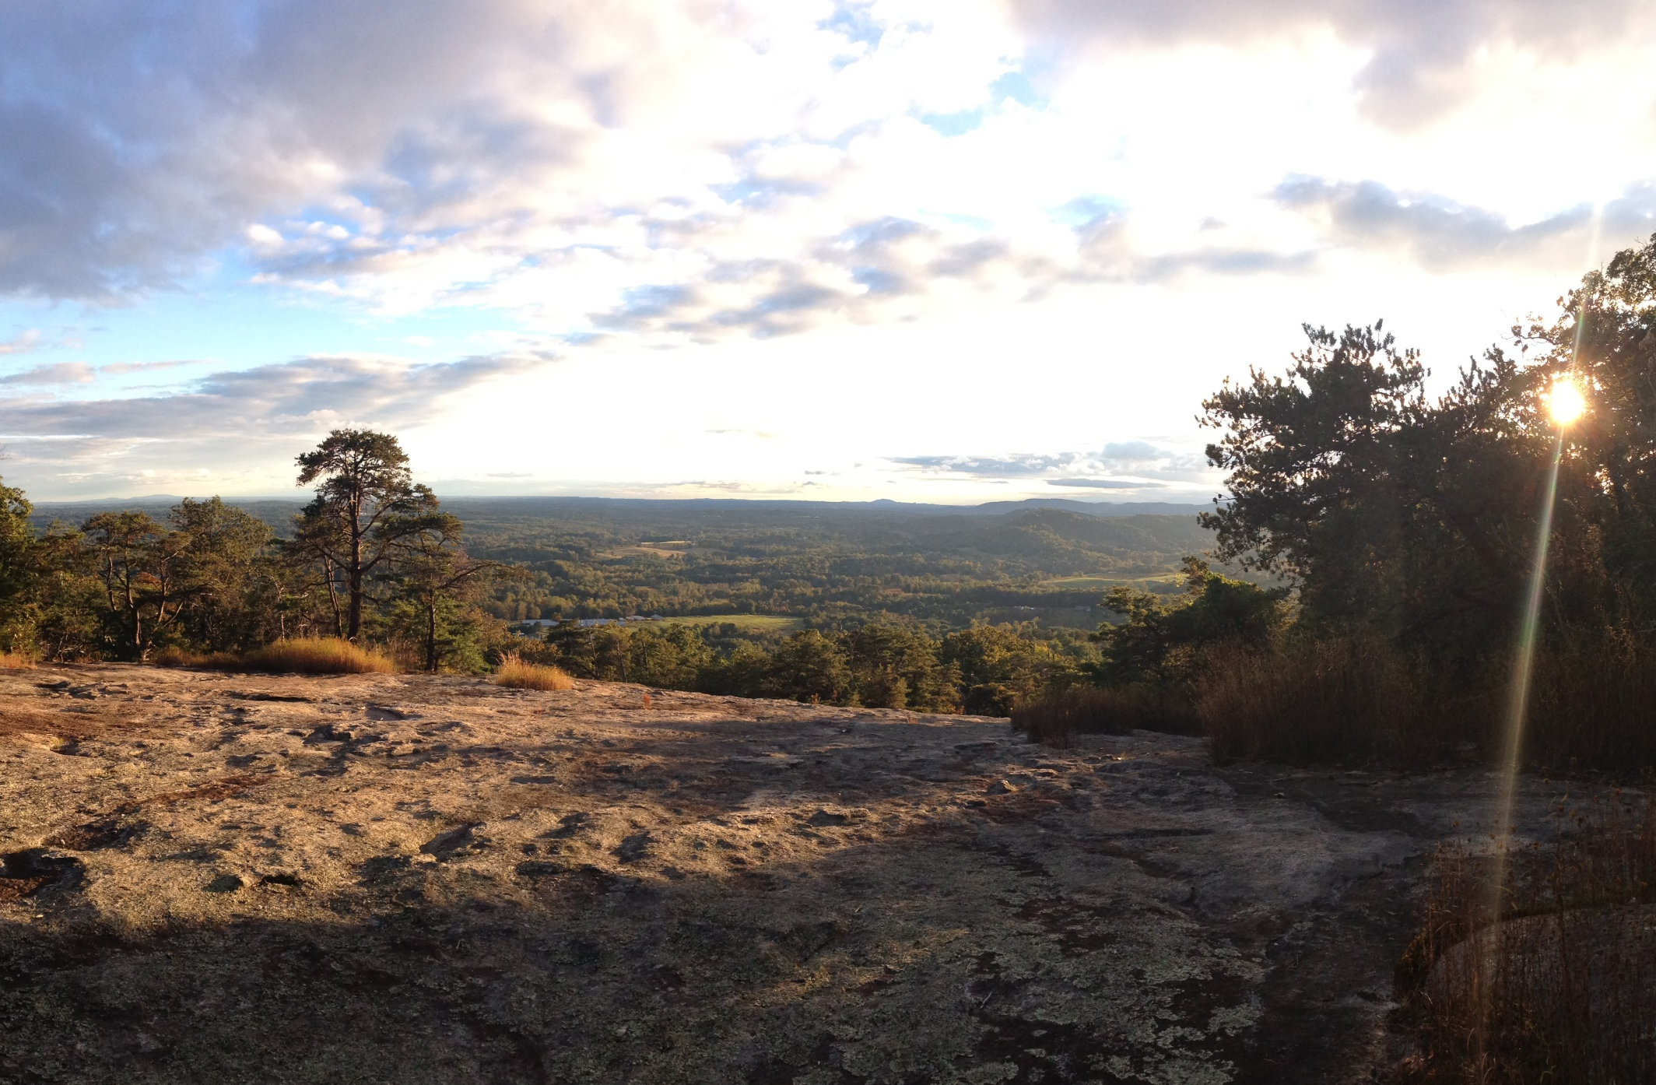
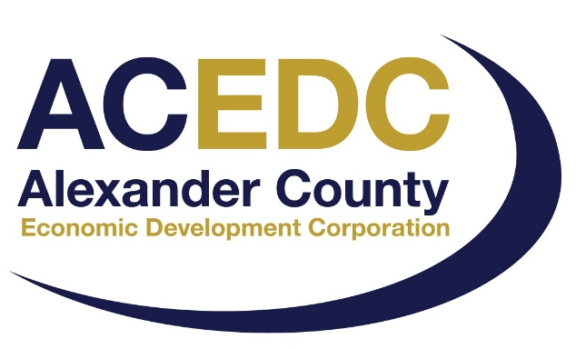
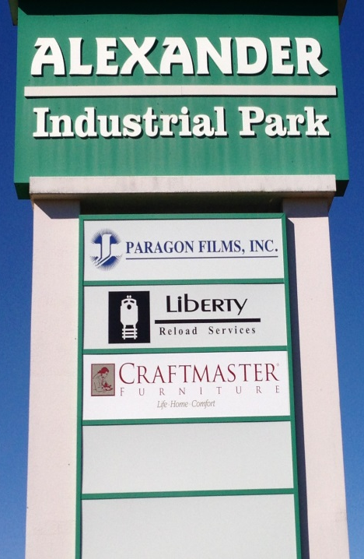
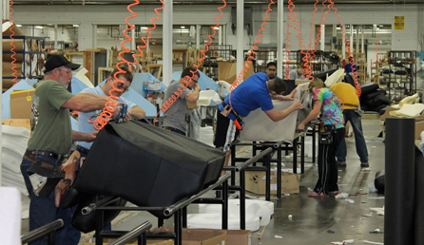
Alexander County Economic Development
Board of Directors: Andrew Jackson, Chairman
Rick French, Vice Chairman
Del Starnes, Secretary
Ryan Mayberry, Board Member
Tim Holder, Board Member
Tim Little, Board Member
Staff: David Icenhour, EDC Director
Connie Kincaid, Bus. Dev. Manager
Gary Herman, Public Information Officer
Notes:
Structure
ACEDC non profit, staffed by county employees.

Slide 2
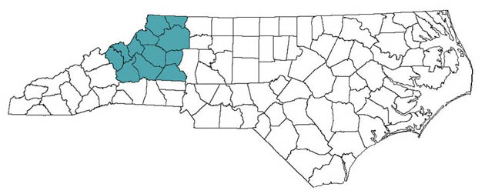
Northwest Prosperity Zone
Alleghany
Ashe
Avery
Burke
Caldwell
Catawba
Mitchell
McDowell
Yancey
Watauga
Wilkes
Alexander County
The State of North Carolina operates eight administrative regions known as Prosperity Zones. Each Zone features a one-stop, physical location, providing citizens and businesses the ability to interact with representatives from multiple state agencies.
The state deploys subject matter experts in each Zone, from transportation and environmental topics to workforce development, community planning and liaisons to existing businesses in the Zones.
Notes:
Structure: How do we fit into the scheme of thins statewide. State of NC effort to streamline service delivery.

Slide 3
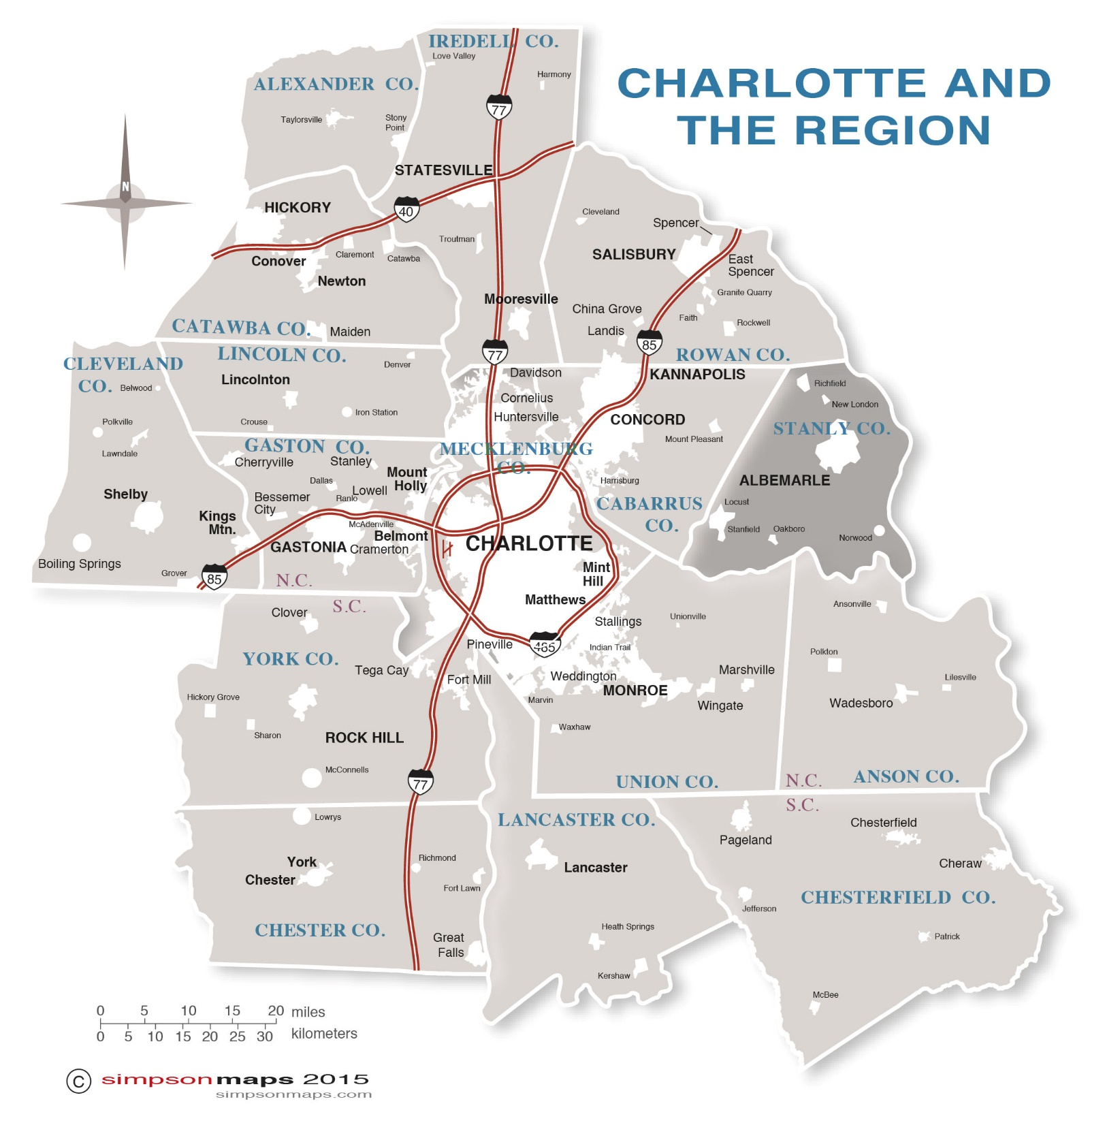

Notes:
Structure: Charlotte Regional Partnership merged with Charlotte Chamber of Commerce.
Membership based. Economic developers searching for companies to locate in region.

Slide 4
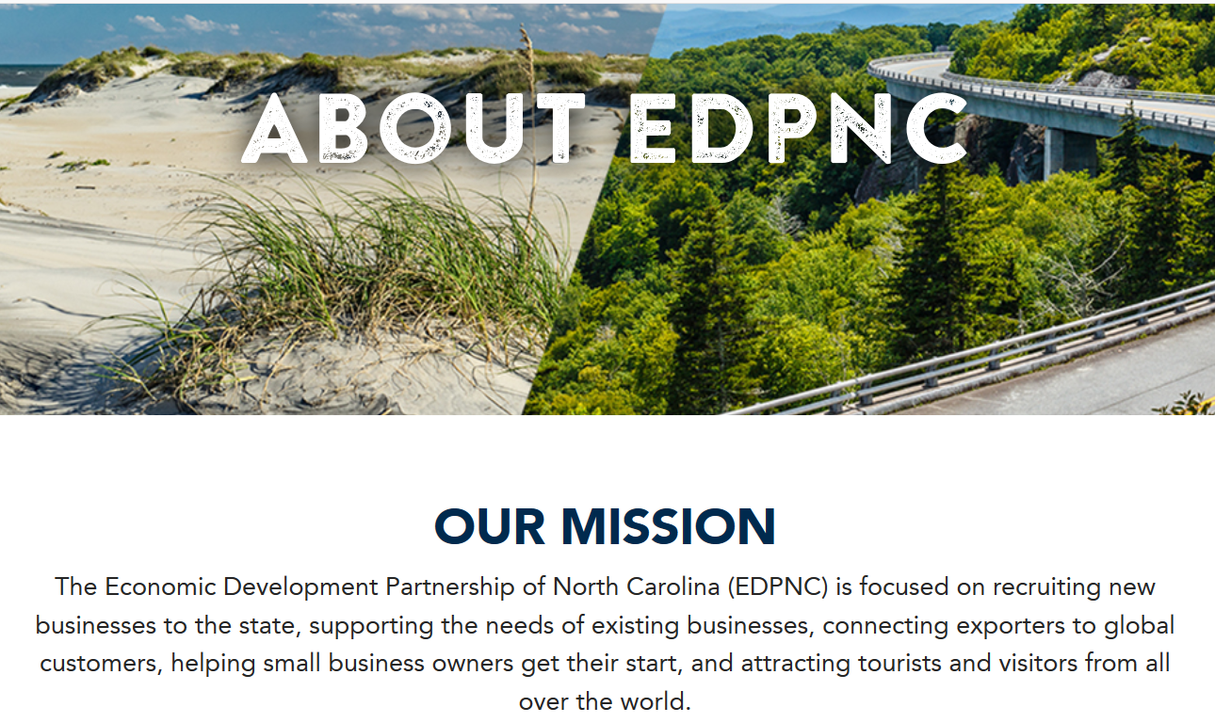
Notes:
Structure: Statewide organization dedicated to brining companies to NC. No cost to counties. Funded by GA and private funds. Some overlap in EDPNC and Charlotte Regional Bus Alliance.

Slide 5
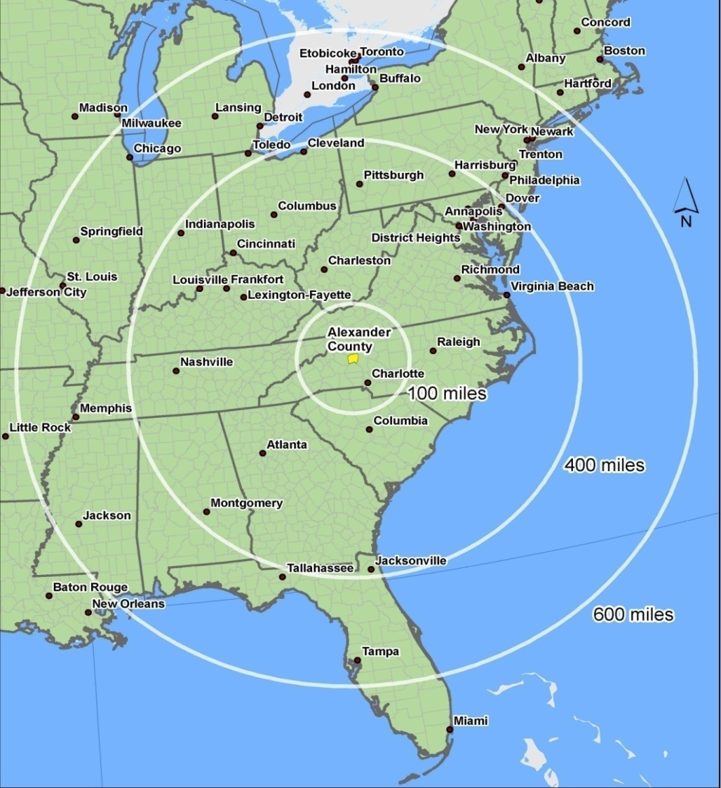
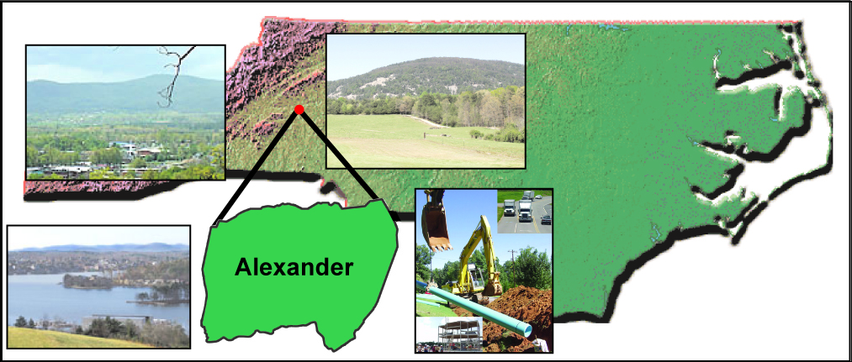
Location
60 miles north of Charlotte
60 miles west of Winston-Salem
90 miles west of Greensboro
90 miles east of Asheville
Surrounding counties:
Catawba , Caldwell, Wilkes , Iredell
259 sq miles
37,000 pop.
Atlanta: 281 miles
Port of Charleston: 260 miles

Slide 6
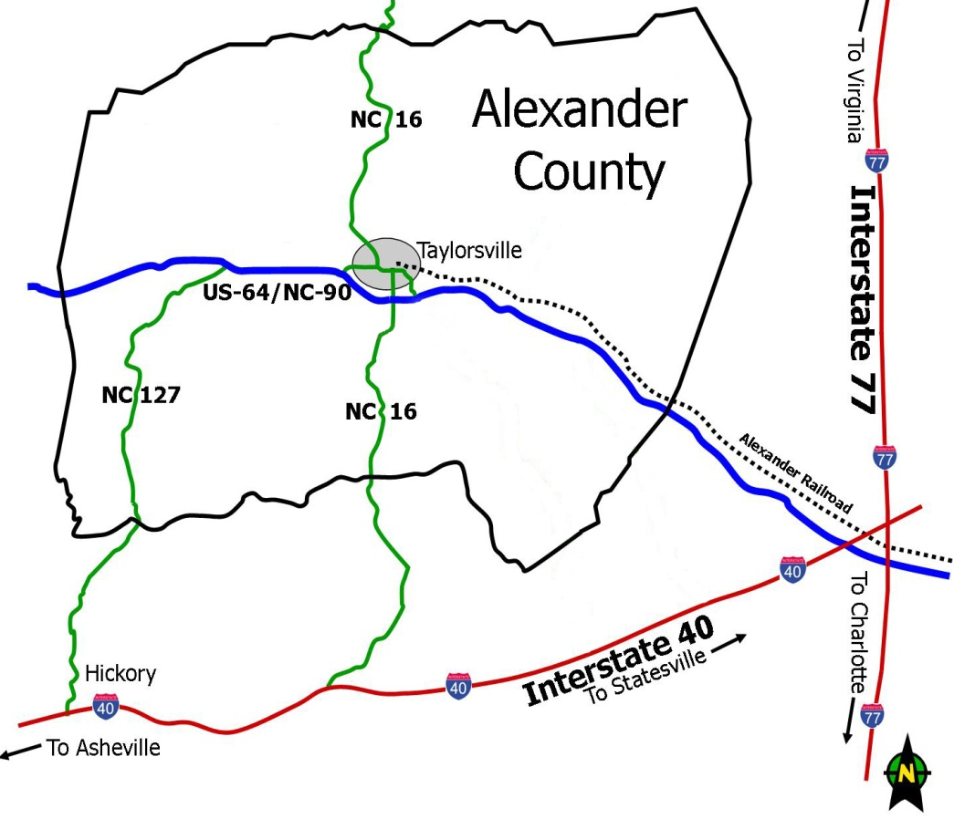
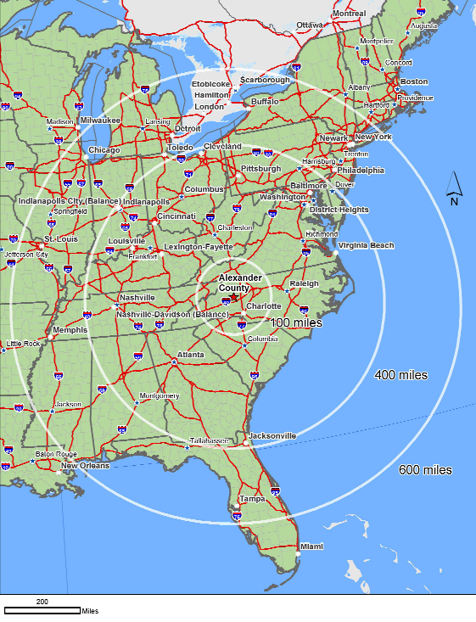
Transportation
Interstate 40 -- 20 minutes
Interstate 77 -- 20 minutes
US Highway 64
NC Highway 16
NC Highway 90
NC Highway 127
Bethlehem

Slide 7
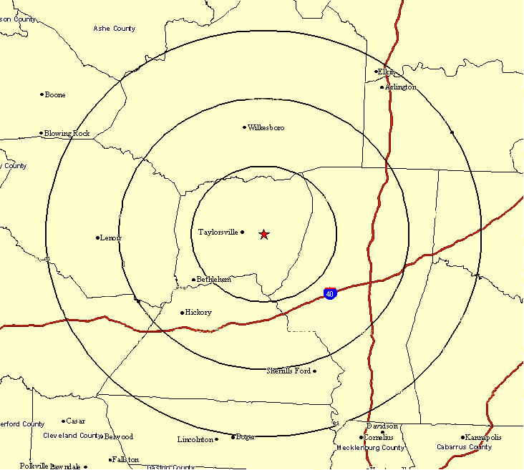
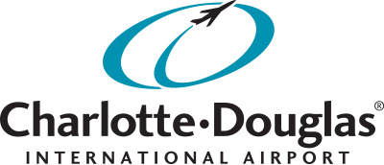
Airport Access
Wilkes County Airport
Runway – 6,200 ft
29.3 miles
Three regional airports
within 30 miles
Alexander Industrial Park
Hickory Regional Airport
Runway – 6,402 ft
26.1 miles
Statesville Airport
Runway – 7,006 ft
16.9 miles
The Charlotte-Douglas International Airport is 64 miles from the
Alexander Industrial Park.

Slide 8
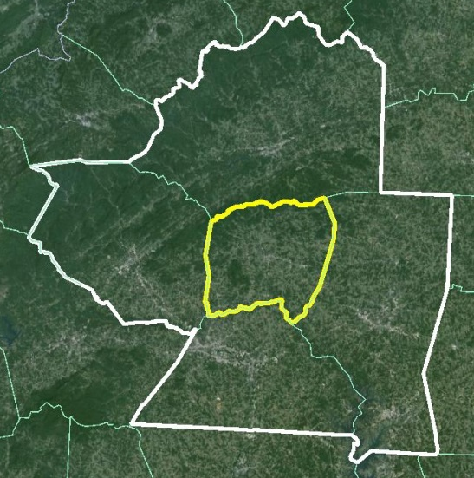
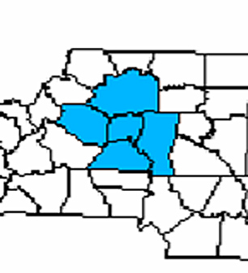
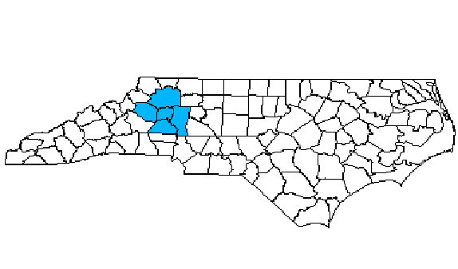
Workforce
ALEXANDER COUNTY
Labor Force: 18,410
Employment: 17,883
Unemployment: 527
Unemployment Rate: 2.9%
Rank in North Carolina: 3rd
November 2018
State Ave Unemployment Rate: 3.5%
Source: North Carolina Department of Commerce
Out migration for employment:
50 + %

Slide 9
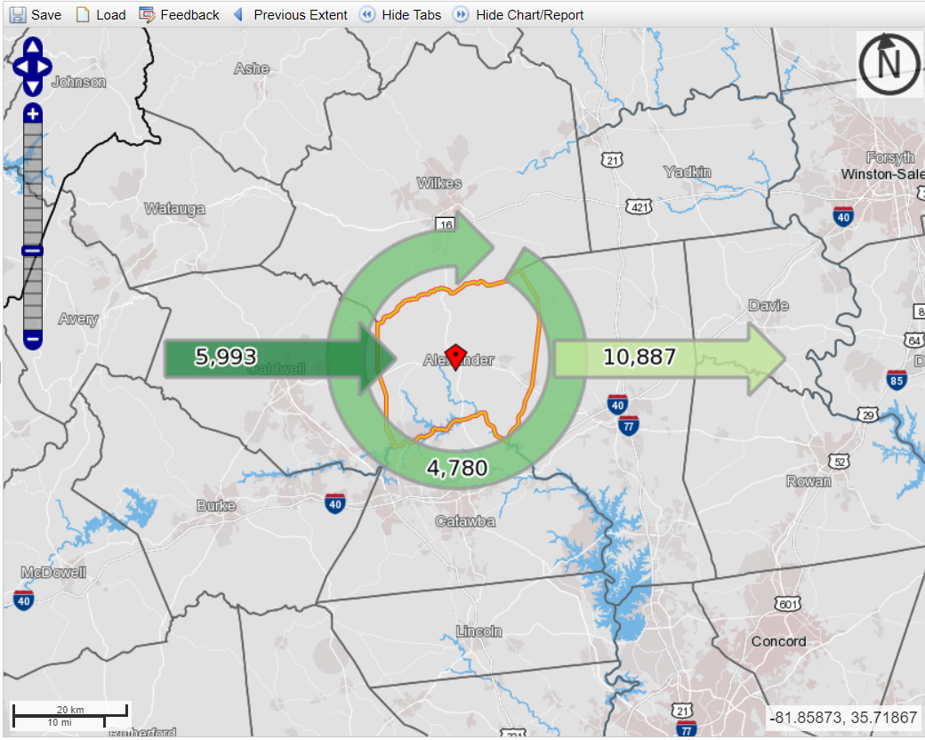
Workforce Commuting Pattern
Source: https://onthemap.ces.census.gov/

Slide 10






Existing Industry
With approximately 40 percent of the workforce holding manufacturing jobs, Alexander County has one of the highest manufacturing workforce percentages in the state.
Paragon Films, the sixth largest stretch film manufacturer in North America, 100,000 sq ft manufacturing space, $15m investment.
Over the last three decades, Huntington House has become synonymous with quality craftsmanship and gorgeous custom upholstered furniture. Employing some 180 artisans.
Schneider Mills, a 60 year-old company. Products used in: aerospace, apparel, filtration fabrics, industrial & military applications. 300 employees.
Mitchell Gold + Bob Williams and Craftmaster Furniture are the county’s two largest industrial employers with more than 1,000 employees.
Opened in 2010 producing carbon fiber materials for the composites industry.
Notes:
Assistance to Industry…. Huntington House Building Renovation Grant $500,000 grant to renovate old Clayton Marcus Bldg.
Mitchell Gold $300,000 grant natural gas extension
Craftmaster $480,000 and $300,000 building renovation grants

Slide 11
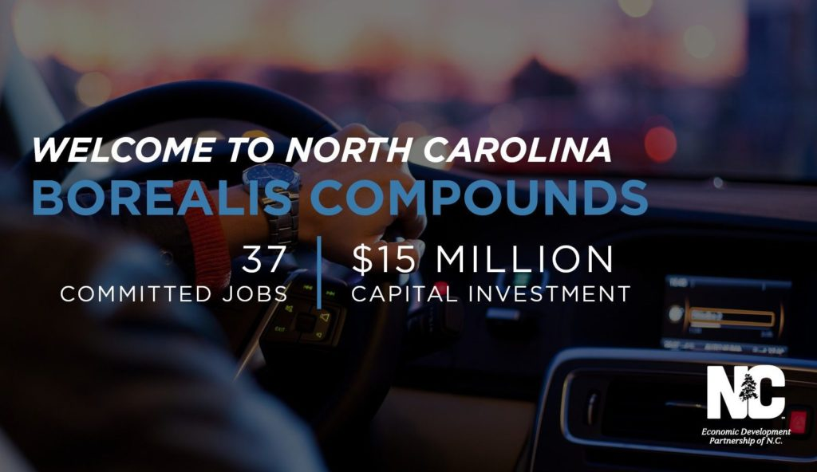
Borealis Announces New Automotive Polypropylene Compounding Plant
Ken Wiecoreck
President, Borealis Compounds Inc.
23 May 2017, Taylorsville, North Carolina
Notes:
Grants

Slide 12

Borealis at a glance
2nd largest polyolefin producer in Europe
Head office
in Vienna, Austria
Production and sales of polyolefins,
base chemicals
and fertilizers
Borouge operates world’s largest integrated PO site in Ruwais, UAE
6,600
employees
Operates in over 120 countries
on 5 continents
+3,500 in Borouge

Slide 13
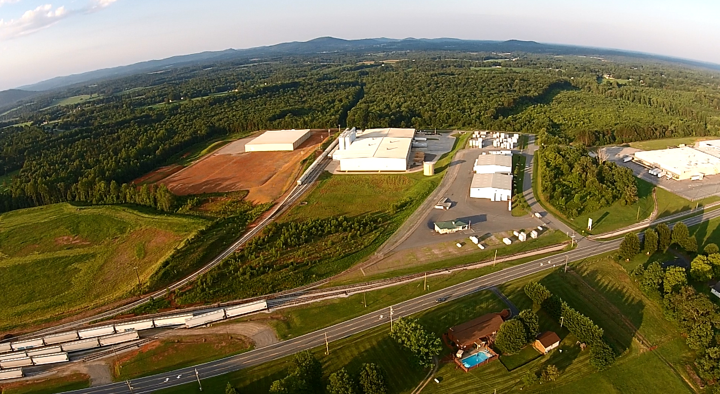
Alexander Industrial Park

Slide 14
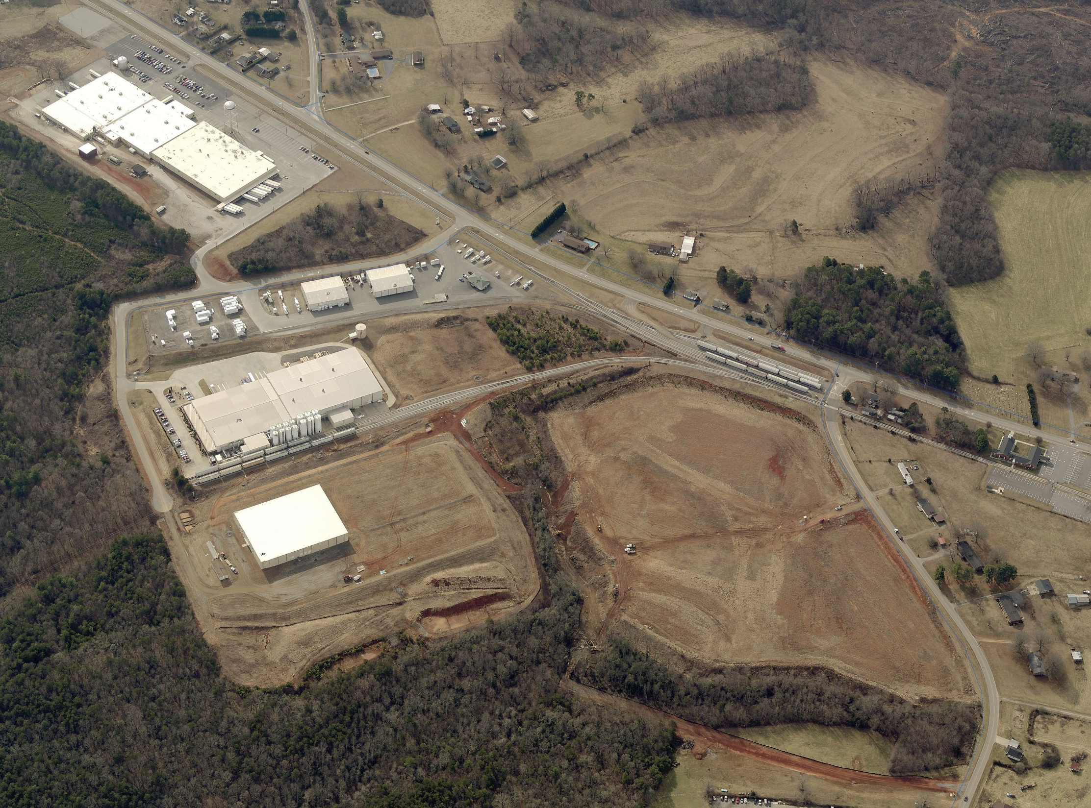
Industrial Park
Craftmaster Furniture
25 acre site
(Beginning site certification process 2018)
Liberty Reload
Paragon Films
25 acre site
Borealis Compounds
Borealis Compounds
New WPS

Slide 15
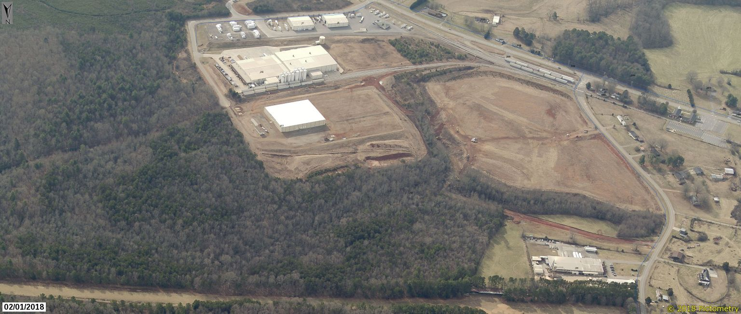
Industrial Park
25 acre site
(Beginning site certification process 2018)
ROAD EXTENSION
Craftmaster Furniture
Liberty Reload
Paragon Films
25 acre site
(Beginning site certification process 2018)
$1.5 m ARC Grant Industrial Road Access
Borealis Compounds
Borealis Compounds
New road opens up new sites

Slide 16
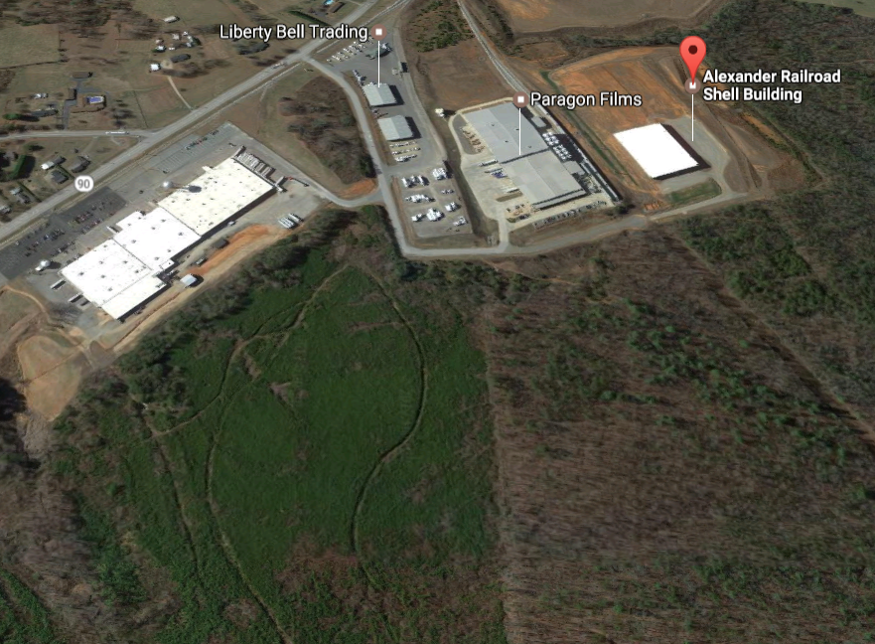
OneRailOfASite.com
Borealis Compounds
Rail-served shell building

Slide 17
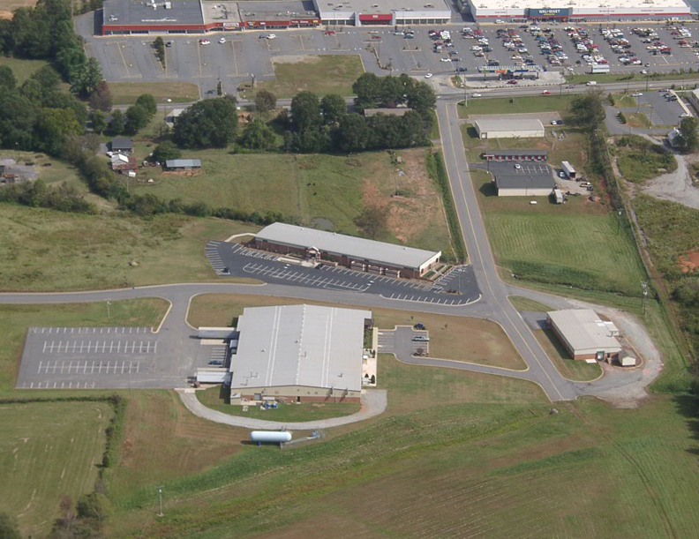

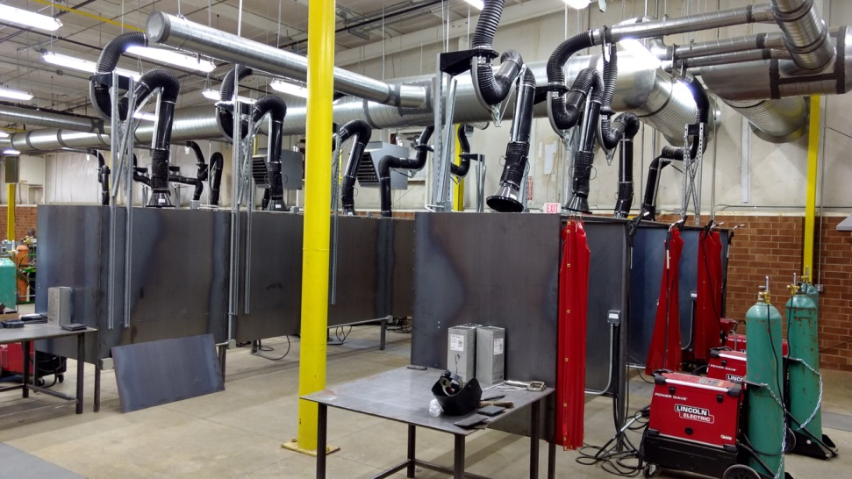
Training
Alexander Applied Technologies Industrial Training Center

Slide 18

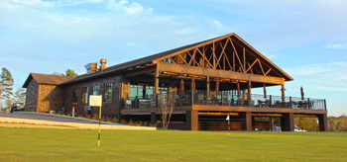
Local Incentives
Alexander County has created a very aggressive local property tax incentive policy. Grants are awarded based on a review of three factors related to a project: Investment over and above the current tax value of a site or building, the number of full time jobs created, and the average weekly pay.
Grants are awarded in four levels:
LEVEL 1: 80%-40% five year descending
LEVEL 2: 90%-50% five year descending
LEVEL 3: 100% five year level
LEVEL 4: 100% six year level with option for additional two years
Tourism Incentive:
Up to 10 years at 100%

Slide 19
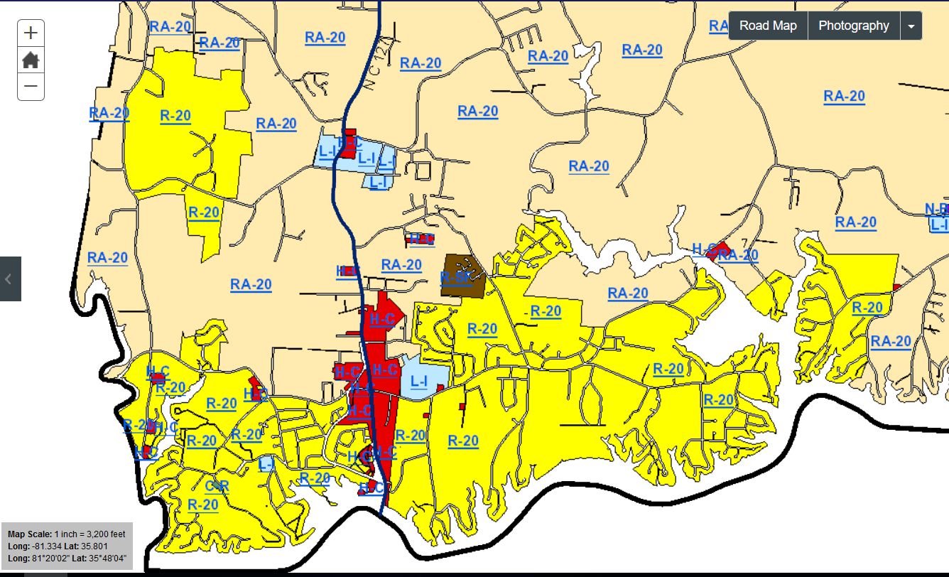
Bethlehem Industrial vs Commercial

Slide 20
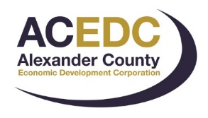
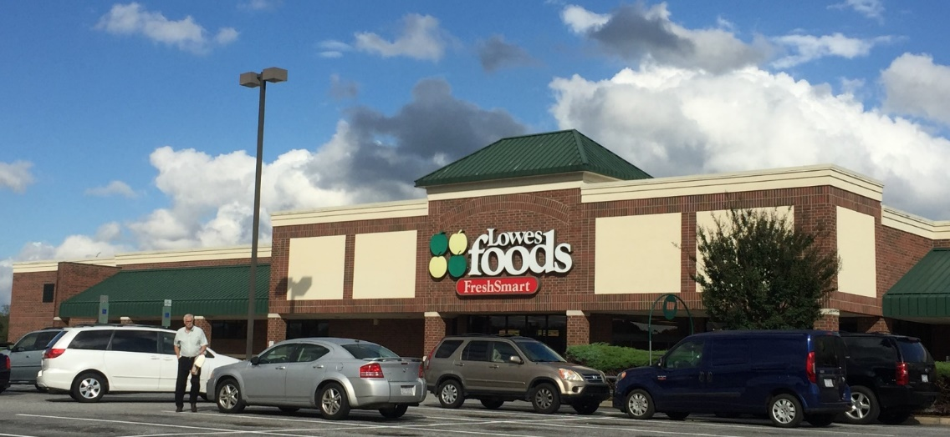
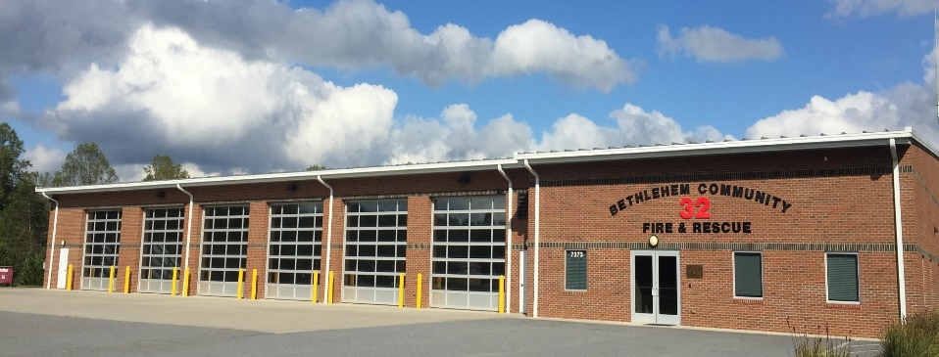
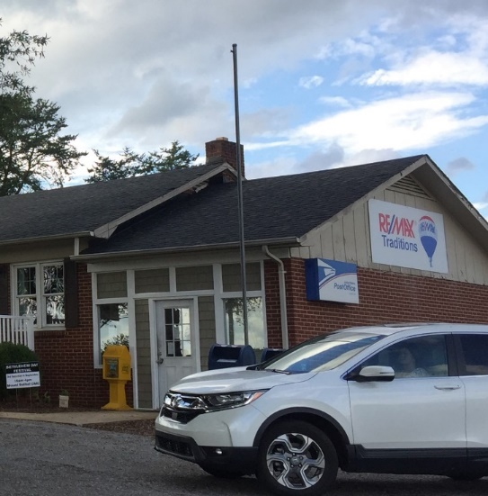
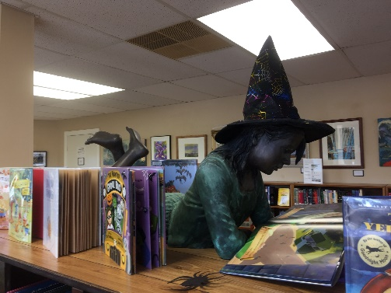
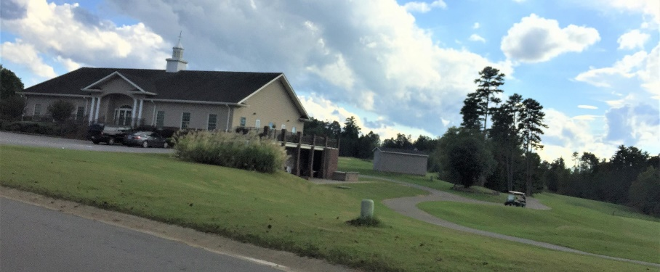
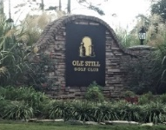
BETHLEHEM, NORTH CAROLINA
Notes:
In the past few months, I’ve been exploring Bethlehem and meeting lots of people. A common thread in conversations with Bethlehem citizens is the desire to create a town center. The plans being made now show the community’s foresight to plan the future. Current assets include a grocery store, a fire station, a library, a golf course, and a post office. All businesses and services that build the basic commercial foundation for a community of 4,422 people. In Alexander County, Bethlehem has the highest property values, the highest education level, and highest household income. That’s one of the reasons so many people want to live here.

Slide 21
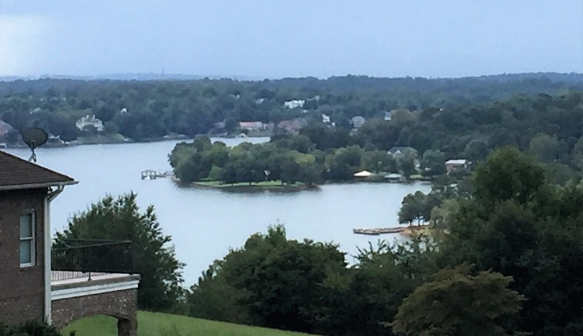
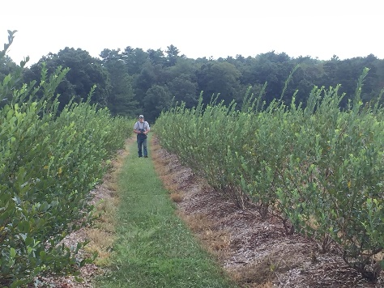
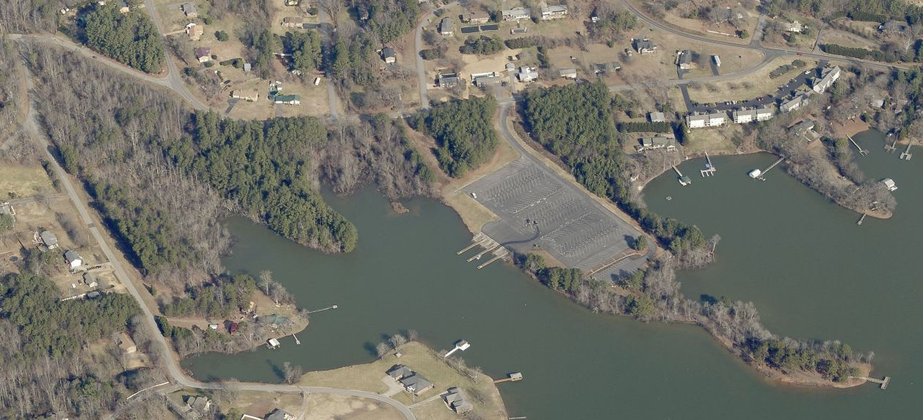
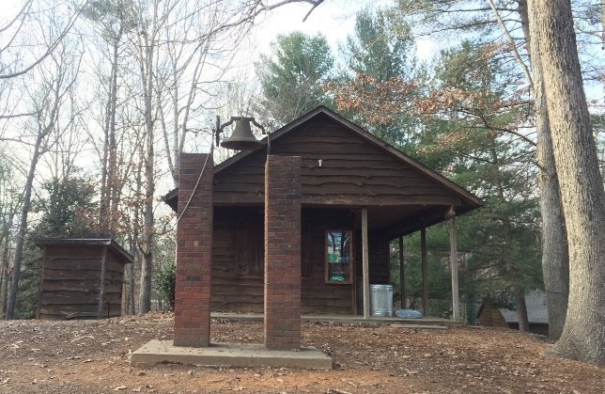
BETHLEHEM, NC
Notes:
Bethlehem has some breathtaking natural resources. Lake Hickory and the Catawba River, Wittenburg public Access to the river, private property lake frontage. A berry farm and a summer camp are added amenities to residents and visitors.

Slide 22
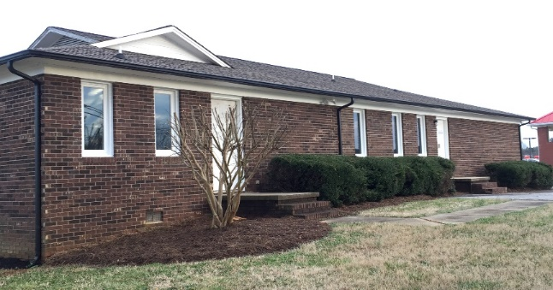
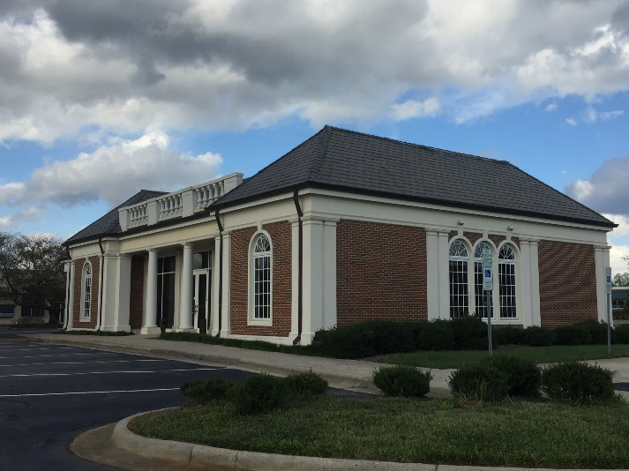
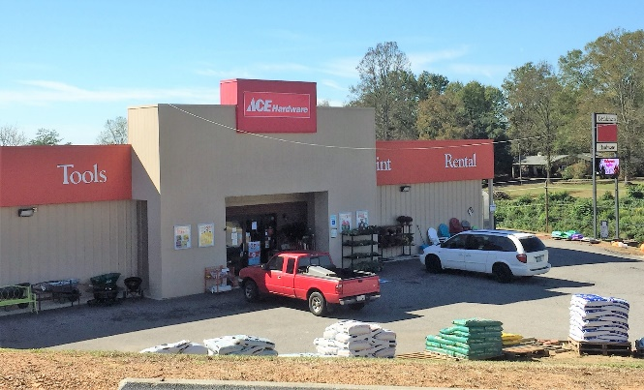
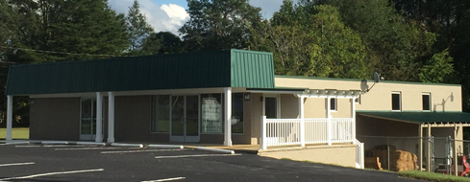
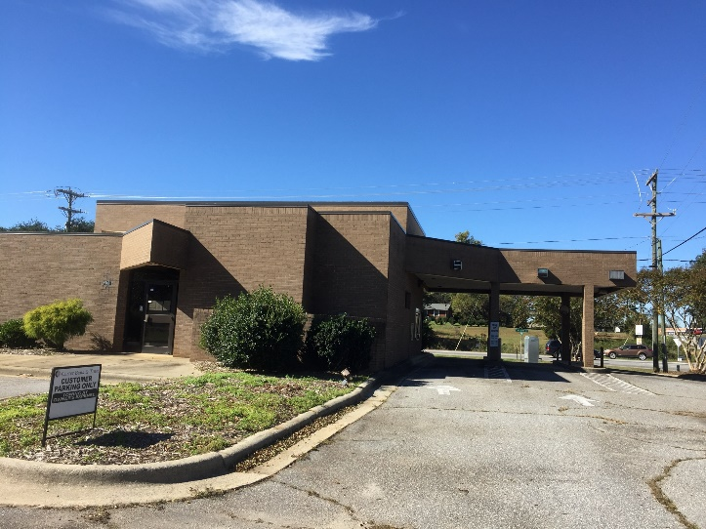
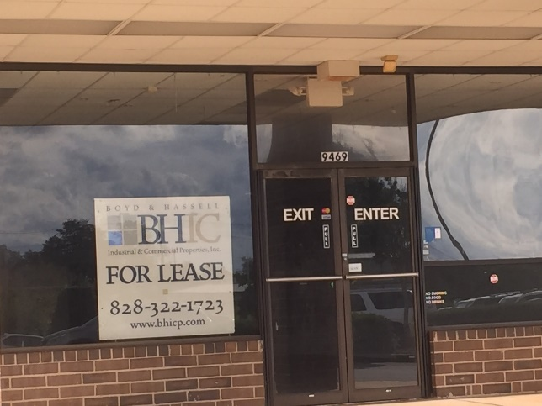
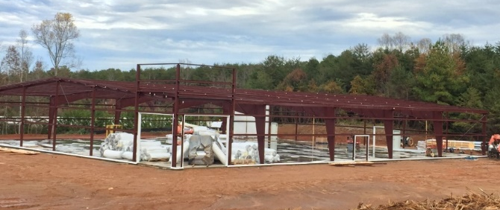
BETHLEHEM, NC

Slide 23

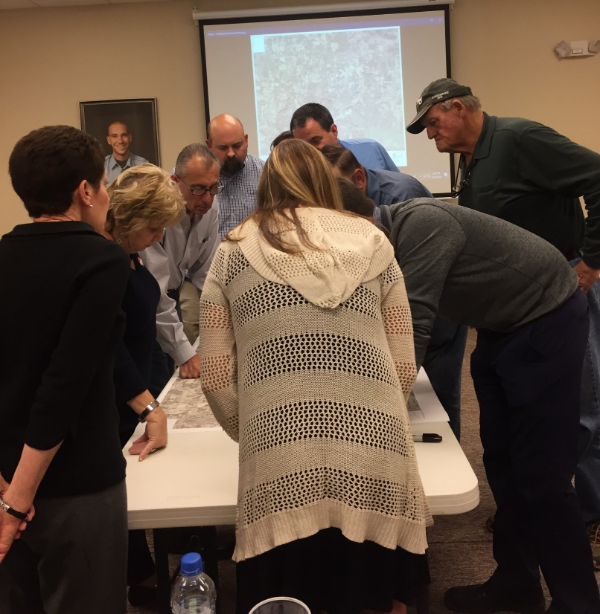
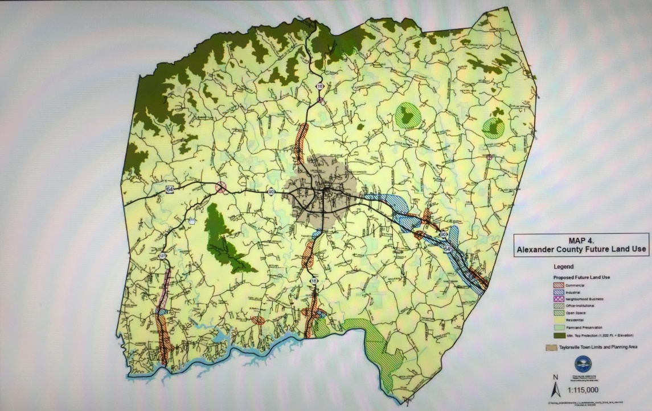
BETHLEHEM, NC
Notes:
The plans you are making now will open the doors for future development opportunities. The expansion of the wastewater system will open up development along Highway 127 and Rink Dam Road. Increased utility capacity will enable more assembly uses and the widening of the road will increase daily traffic. We have been researching site selection criteria for many companies with preliminary contact on specific real estate. Many of the corporate contacts would like to see final plans and timelines for the project. Once we know where the road will be, we will be better equipped to encourage new businesses to make Bethlehem their home.

Slide 24
END

