Slide 1
GREATER HICKORY METROPOLITAN PLANNING ORGANIZATION
2026 Congestion Management Process (CMP) Report
Regional System Performance Benchmark & Multi-Modal Bottleneck Prioritization
For Alexander, Burke, Caldwell, and Catawba Counties
GHMPO MPO Board & Technical Coordinating Committee Briefing | Adopted 2026

Slide 2
2026 CONGESTION MANAGEMENT PROCESS (CMP) REPORT
Acronym Reference Guide & Transportation Planning Glossary
CMP: Congestion Management Process — Federally mandated systematic regional diagnostic process.
STIP: State Transportation Improvement Program — Funded 10-year NCDOT construction schedule.
GHMPO: Greater Hickory Metropolitan Planning Organization (Alexander, Burke, Caldwell, Catawba).
2055 MTP: 2055 Metropolitan Transportation Plan — 25-year long-range regional transportation vision.
NCDOT: North Carolina Department of Transportation.
CTP: Comprehensive Transportation Plan — Multi-modal unconstrained long-range planning vision.
P.8: Prioritization 8.0 — Active NCDOT competitive project scoring cycle for state transportation funding.
RITIS: Regional Integrated Transportation Information System — Probe-based speed/delay analytics.
PTI: Planning Time Index — Measures travel reliability (95th percentile travel time / free-flow time).
RCI: Reduced Conflict Intersection — Superstreet / J-turn design that eliminates cross-median crashes.
TTI: Travel Time Index — Measures average peak congestion (peak travel time / free-flow time).
VMT: Vehicle Miles Traveled — Measure of total regional vehicular volume.
EPDO: Equivalent Property Damage Only — Standard crash severity weighting formula.
HSIP: Highway Safety Improvement Program — Dedicated federal safety funding source.

Slide 3
2026 CONGESTION MANAGEMENT PROCESS (CMP) REPORT
Federal Framework & CMP Transportation Planning Pipeline
1. SYSTEM DIAGNOSTIC
Continuous Probe Monitoring
Tracks real-time speed, travel time reliability (PTI/TTI), delay hours, and crash hotspots across Alexander, Burke, Caldwell, and Catawba counties.
2. SOLUTION FORMULATION
Tiered Countermeasures
Scales immediate short-term operational fixes (signal timing, widening, turn lanes) alongside long-term capital investments.
3. PROJECT LINKAGE
2055 MTP & P.8 Funding
Feeds vetted bottleneck projects directly into NCDOT Prioritization 8.0 (P.8), the STIP construction schedule, and 2055 MTP.

Slide 4
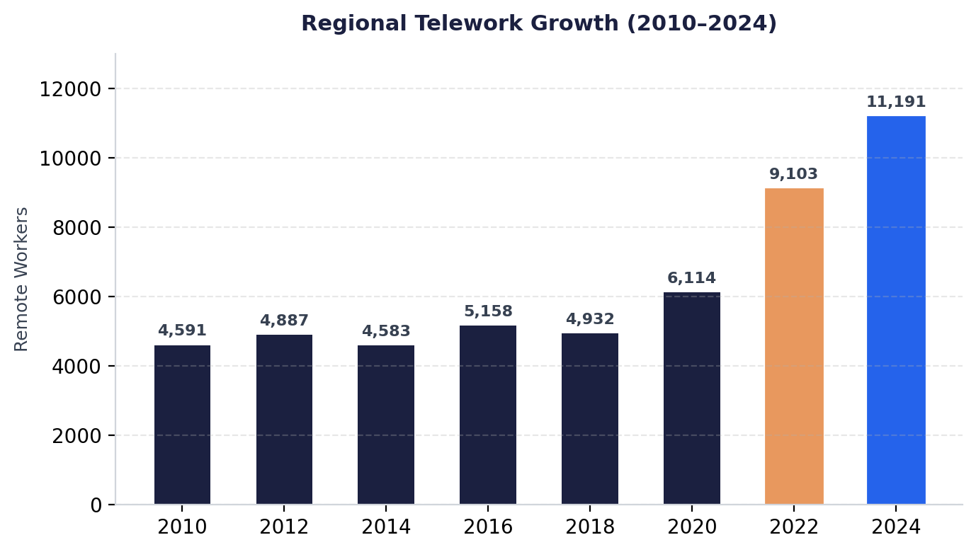
2026 CONGESTION MANAGEMENT PROCESS (CMP) REPORT
Post-Pandemic Telework Expansion: 126.9% Growth Since 2018
Regional Telework Breakdown & Census ACS Analysis:
• 126.9% Regional Remote Work Surge: Regional teleworking expanded from 4,932 workers in 2018 to 9,103 in 2022, reaching 11,191 in 2024 (+6,259 remote workers).
• Catawba County Dominance: Remote workers in Catawba County surged 164.3% from 2,361 (2019) to 6,241 (2024)—accounting for 55.8% of the region's entire remote workforce.
• Caldwell & Burke Expansion: Caldwell reached 2,561 remote workers (+108.4% from 2019) while Burke grew to 2,147 (+58.8%). Alexander reached 962 (+64.2%).
• Peak-Hour Rush Flattening: Shifting 11,191 commuters to remote work removes over 22,000 daily trips from primary corridors during morning (7-9 AM) and evening (4.5-6.5 PM) commute windows.

Slide 5
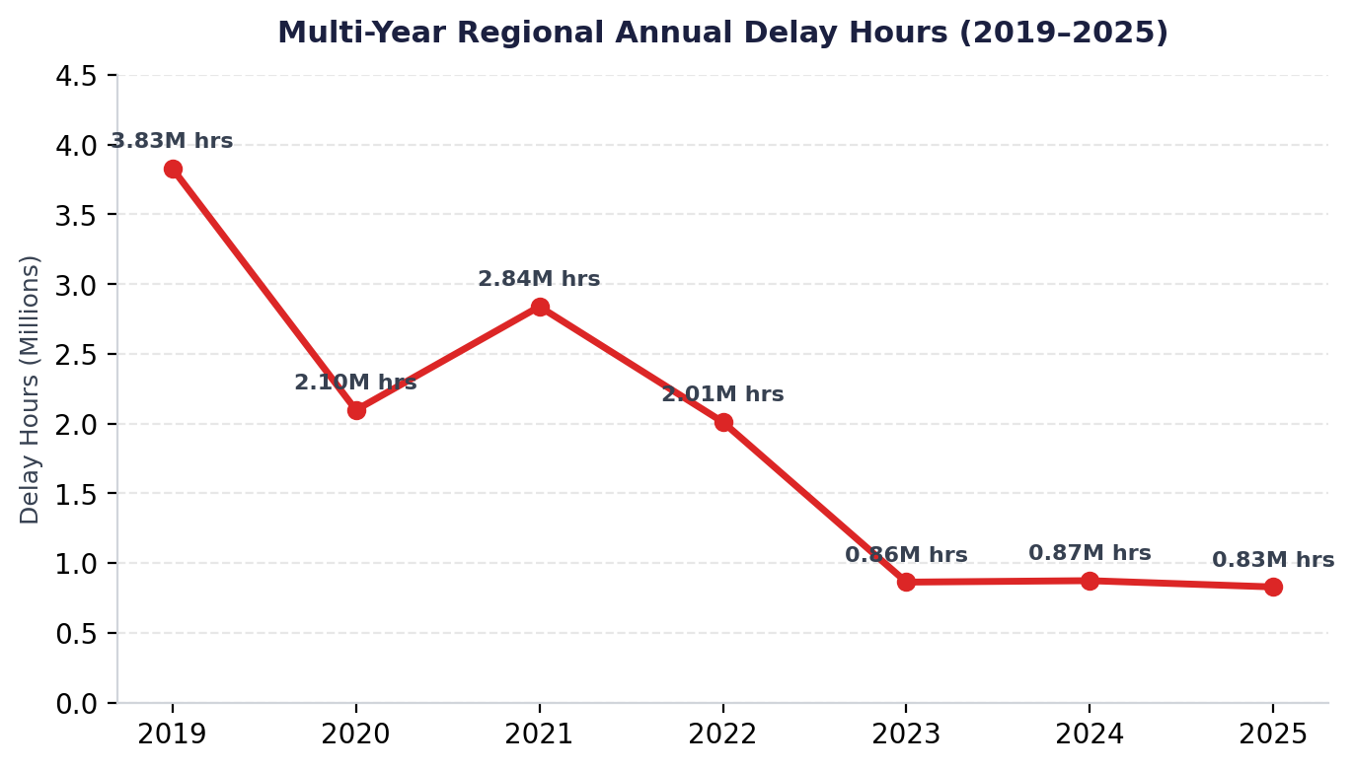
2026 CONGESTION MANAGEMENT PROCESS (CMP) REPORT
Multi-Year Annual Delay Reduction: -78.4% Drop Since 2019
The VMT vs. Delay Hours Disconnect:
• Plunge in Total Congestion Hours: Total annual regional delay hours dropped from 3,828,647 hours in 2019 down to 863,135 in 2023, 873,703 in 2024, and 828,515 in 2025 (-78.4%).
• VMT Recovery vs. Delay Suppression: Total regional Vehicle Miles Traveled (VMT) fully returned to 100% of pre-pandemic baselines by 2022, yet delay hours remain at historic lows.
• Mechanism of Delay Suppression: Expanded telework and flexible scheduling spread travel demand into off-peak hours, keeping traffic volumes below critical highway capacity thresholds.
• System Resiliency: The reduction in peak directional surges allows existing highway infrastructure to operate with significantly higher travel time reliability.

Slide 6
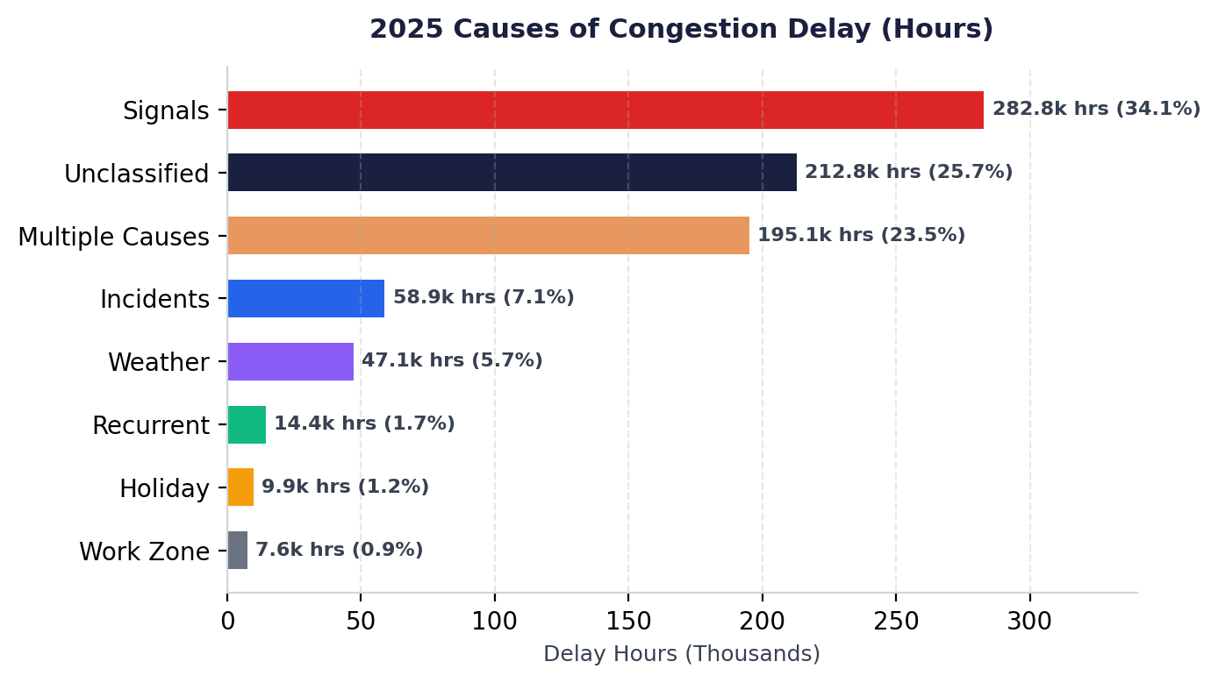
2026 CONGESTION MANAGEMENT PROCESS (CMP) REPORT
2025 Primary Causes of Delay: Traffic Signals as #1 Operational Driver
Operational Diagnostic & Event Classification:
• Traffic Signals (#1 Cause): Accounts for 282,772 hours (34.1% of classified delay), making signal coordination and adaptive retiming the most cost-effective interim solution.
• Unclassified Delay (25.7%): 212,763 hours caused by unreported stalls, merging friction, driver hesitation, and localized commercial driveway conflicts.
• Multiple Causes (23.5%): 195,115 hours occurring when 2+ events overlap (e.g. crashes in work zones during rain). Assigned to a single mutually exclusive bucket to avoid double-counting.
• Incidents & Weather: Incidents caused 58,907 hours (7.1%) while weather added 47,143 hours (5.7%). Recurrent capacity bottlenecking accounted for just 14,416 hours (1.7%).

Slide 7
2026 CONGESTION MANAGEMENT PROCESS (CMP) REPORT
Cross-County Commuting Dynamics: 47.9% Out-of-County Work Flow
DECLINING LOCAL EMPLOYMENT
In-County Alignment Drops to 52.1%
Workers residing and working in the same county fell from 64.3% in 2005 to 52.8% in 2020 and 52.1% in 2023. Over 47.9% of all regional workers now commute across county borders daily.
CATAWBA REGIONAL JOB HUB
Heavy Inbound Commute Attraction
Catawba County serves as the central economic engine, drawing over 6,800 daily commuters from Caldwell, 2,400 from Burke, and 4,100 from Alexander County along primary arterials.
CORRIDOR RELIANCE
Pressure on Primary Trunk Lines
Regional commuting places intense daily pressure on primary inter-county trunk lines: I-40, US-321, NC-16, NC-150, and US-64, driving the need for multi-modal corridor coordination.

Slide 8
2026 CONGESTION MANAGEMENT PROCESS (CMP) REPORT
CMP Composite Evaluation Methodology: 50-Point Scoring Framework
1. BOTTLENECK VOLUME RANK (Max 10 Points): Measures raw queue duration and delay volume derived from RITIS probe analytics. Ranks 1-5 receive 10 pts; Ranks 6-10 receive 7 pts; Ranks 11-15 receive 5 pts; Ranks 16-20 receive 3 pts; Ranks 21-25 receive 1 pt.
2. TRAVEL RELIABILITY (PTI) (Max 10 Points): Planning Time Index (95th percentile buffer time). Evaluates travel time unreliability and required buffer time. PTI > 3.0 = 10 pts; 2.0-3.0 = 7 pts; 1.5-2.0 = 5 pts; 1.2-1.5 = 3 pts.
3. PEAK CONGESTION (TTI) (Max 10 Points): Travel Time Index (peak / free-flow speed). Evaluates average peak congestion levels. TTI > 2.0 = 10 pts; 1.5-2.0 = 7 pts; 1.2-1.5 = 5 pts; 1.1-1.2 = 3 pts.
4. ACCIDENT FREQUENCY (Max 10 Points): Total reported crash volume over the 2024-2025 evaluation window. Evaluates non-recurring safety risk. Crashes > 40 = 10 pts; 30-40 = 7 pts; 20-30 = 5 pts; 10-20 = 3 pts.
5. SEVERITY INDEX (EPDO) (Max 10 Points): Equivalent Property Damage Only rating (EPDO points / crash total). Measures crash severity. Severity Index > 5.0 = 8-10 pts; 3.0-5.0 = 5-7 pts; 1.5-3.0 = 2-4 pts.

Slide 9
2026 CONGESTION MANAGEMENT PROCESS (CMP) REPORT
Safety Scoring Framework: Crash Frequency vs. EPDO Severity Index
1. Accident Count Scoring (Max 10 Pts)
• Measures non-recurring congestion frequency and crash incident probability across the 2024-2025 tracking window.
• High-Volume Hotspots: Locations with 40+ crashes (e.g. US-321 N @ Maizel Rd with 47 crashes, NC-181 N with 45 crashes) receive the full 10-point maximum.
• Moderate-Volume Locations: 30-40 crashes earn 7 points (e.g. NC-150 @ NC-16 with 32 crashes); 20-30 crashes earn 5 points.
• Lower-Volume Locations: <10 crashes earn 0-3 points, ensuring safety points are directed where crash frequency is highest.
2. EPDO Severity Index Scoring (Max 10 Pts)
• Formula: Severity Index = Total EPDO (Equivalent Property Damage Only) Points / Total Crash Count.
• Severity Weighting: Distinguishes minor property-damage collisions (1.0 EPDO) from severe injury and fatal crashes (weighted up to 76+ EPDO).
• High Severity Spotlights: US-321N @ Mt Herman Rd features a regional-high 12.71 Severity Index (earning 8 Severity Pts).
• Commercial Access Risks: US-70 W @ Malcolm Blvd features a 5.23 Severity Index (7 Severity Pts) due to high-speed commercial turning conflicts.

Slide 10
2026 CONGESTION MANAGEMENT PROCESS (CMP) REPORT
Understanding RITIS Volume Rank vs. Composite CMP Priority Score
RITIS Bottleneck Rank (1 to 30)
• Pure Measure of Delay Volume: Measures raw queue length, daily congestion duration, and vehicle-hours of delay.
• Feeds 1 Category (Max 10 Pts): Ranks 1-5 receive 10 pts in the CMP matrix; Ranks 26-30 receive 0 pts.
• Case Study — McDonald Pkwy S @ I-40: Holds Bottleneck Volume Rank #1 due to massive daily interchange queuing, earning 10.0 Bottleneck points.
CMP Composite TOTAL Score (Out of 50)
• Comprehensive Priority Metric: Sums Bottleneck Volume (10) + PTI Reliability (10) + TTI Congestion (10) + Crash Count (10) + Severity Index (10).
• Multi-Dimensional Assessment: Allows a location with moderate raw delay to rank as the #1 regional priority if travel reliability is severe and crashes are high.
• Case Study — NC-181 N @ Union St: Holds Volume Rank #15 (5.0 Bottleneck pts), but maxes out in Travel Unreliability (PTI 2.7) and Crash Volume (45 crashes), giving it the #1 Highest CMP Composite Score (32.0).

Slide 11
2026 CONGESTION MANAGEMENT PROCESS (CMP) REPORT
2026 Regional Bottleneck Summary: Overall Score Drop to 15.83
15.83 PTS
2026 Regional Average Score
Down from 16.87 in 2024 (-6.1% reduction) across top 30 bottlenecks.
13 SITES
Catawba County Focus
Represents 43.3% of regional bottlenecks, centered on I-40, US-321, and NC-127.
12 SITES
Burke County Focus
Represents 40.0% of regional bottlenecks, centered on Morganton I-40 interchange ramps.
5 SITES
Caldwell & Alexander
Caldwell holds 3 sites (US-321 corridor); Alexander holds 2 sites (NC-16 corridor).

Slide 12
2026 CONGESTION MANAGEMENT PROCESS (CMP) REPORT
2026 Complete Regional Bottleneck Inventory: All 30 Priority Locations
# | Head Location | County | '26 Score | '24 Score | PTI | TTI | Crashes
1 | NC-181 N @ US-64/US-70-BR/.. | Burk | 32.0 | 33.0 | 2.7 | 1.8 | 45
2 | NC-150 W @ NC-16 | Cata | 31.0 | 29.0 | 2.1 | 1.5 | 32
3 | US-64 W @ I-40 | Burk | 29.0 | 29.0 | 2.5 | 1.4 | 42
4 | MCDONALD PKWY S @ I-40 | Cata | 27.0 | 27.0 | 1.4 | 1.1 | 38
5 | US-321-ALT S @ US-321/HICK.. | Cald | 26.0 | 26.0 | 4.2 | 3.1 | 12
6 | 29th Ave Dr NE @ NC-127/N .. | Cata | 25.0 | 6.0 | 3.4 | 1.9 | 27
7 | NC-18 S @ I-40/BUSH DR | Burk | 23.0 | 25.0 | 1.4 | 1.2 | 15
8 | US-321 N @ MAIZEL RD/NEW F.. | Cald | 23.0 | 25.0 | 1.4 | 1.1 | 47
9 | US-70 W @ MALCOLM BLVD | Burk | 18.0 | 25.0 | 1.2 | 1.1 | 16
10 | I-40 W @ BETHEL RD/EXIT 106 | Burk | 16.0 | 22.0 | 1.1 | 1.1 | 8
11 | NC-16 N @ US-64/NC-90/W MA.. | Alex | 15.0 | 22.0 | 1.3 | 1.1 | 16
12 | I-40 W @ US-321/EXIT 123 | Cata | 15.0 | 21.0 | 1.7 | 1.1 | 18
13 | US-321 S @ 2ND AVE | Cata | 15.0 | 21.0 | 1.2 | 1.1 | 27
14 | I-40 W @ EXIT 125 | Cata | 15.0 | 20.0 | 1.2 | 1.0 | 43
15 | US-70 E @ LENOIR RHYNE BLV.. | Cata | 15.0 | 20.0 | 1.4 | 1.1 | 38
# | Head Location | County | '26 Score | '24 Score | PTI | TTI | Crashes
16 | US-321N @ Mt Herman Road | Cald | 14.0 | 6.0 | 1.3 | 1.1 | 9
17 | I-40 W @ NC-1715/N OXFORD .. | Cata | 13.0 | 19.0 | 1.2 | 1.1 | 13
18 | I-40 W @ OLD NC-10/NC-1761.. | Burk | 13.0 | 18.0 | 1.1 | 1.0 | 14
19 | I-40 W @ NC-114/EXIT 107 | Burk | 13.0 | 15.0 | 1.3 | 1.1 | 6
20 | US-70 E @ NC-1476/FAIRGROV.. | Cata | 11.0 | 13.0 | 1.3 | 1.1 | 16
21 | MCDONALD PKWY @ US 70/US 3.. | Cata | 11.0 | 13.0 | 1.4 | 1.1 | 32
22 | NC-127 @ 2nd Ave SE | Cata | 11.0 | 13.0 | 1.2 | 1.0 | 41
23 | I-40 E @ CENTER ST/EXIT 119 | Burk | 10.0 | 9.0 | 1.1 | 1.1 | 5
24 | NC-10E @ NC-127 | Cata | 10.0 | 6.0 | 1.2 | 1.1 | 19
25 | I-40 W @ NC-18/EXIT 105 | Burk | 9.0 | 9.0 | 1.1 | 1.1 | N/a
26 | I-40 W @ OLD NC-10/EXIT 118 | Burk | 9.0 | 9.0 | 1.6 | 1.1 | N/a
27 | NC-16 N @ US-64 | Alex | 7.0 | 7.0 | 1.3 | 1.1 | 13
28 | I-40W @ Mineral Springs Mo.. | Burk | 7.0 | 6.0 | 1.1 | 1.1 | N/a
29 | I-40W @ Malcolm BLVD/Exit .. | Burk | 6.0 | 6.0 | 1.4 | 1.1 | 7
30 | US-64 @ NC-90/NC-18/HARPER.. | Cald | 6.0 | 6.0 | 1.6 | 1.1 | 11

Slide 13
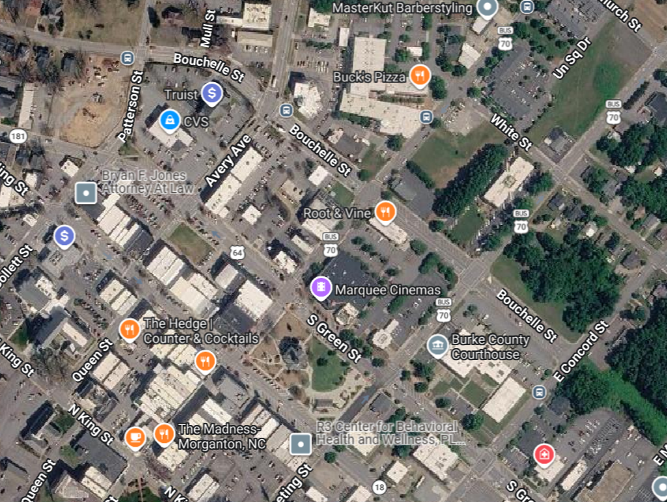
2026 CONGESTION MANAGEMENT PROCESS (CMP) REPORT
Priority #1: NC-181 N @ US-64/US-70-BR/Union St (Burke)
2026 Score: 32.0 / 50 | 2024 Score: 33.0 | Volume Rank: #15
County: Burke | PTI: 2.70 | TTI: 1.80 | Safety: 45 Crashes (2024-2025) | N/a Severity
OPERATIONAL DIAGNOSTIC
Severe travel time unreliability (PTI 2.70) and high crash frequency (45 total crashes) make this the #1 overall CMP priority.
RECOMMENDED SHORT-TERM COUNTERMEASURES
Signal coordination & timing optimization; dual left-turn lane extension; access control.
RECOMMENDED LONG-TERM CAPITAL PROGRAM
Include as long-term capital candidate in 2055 MTP & CTP bypass corridor study; conduct Road Safety Audit (RSA).
[ ATTACH INTERSECTION MAP /
SATELLITE SCREENSHOT HERE ]
GIS Reference Frame — NC-181 N @ US-64/US-70-BR/Union St (Burke)

Slide 14
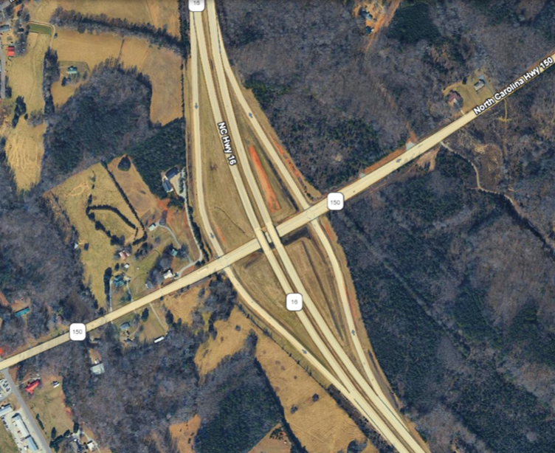
2026 CONGESTION MANAGEMENT PROCESS (CMP) REPORT
Priority #2: NC-150 W @ NC-16 (Catawba)
2026 Score: 31.0 / 50 | 2024 Score: 29.0 | Volume Rank: #8
County: Catawba | PTI: 2.10 | TTI: 1.50 | Safety: 32 Crashes | 1.99 Severity Index
OPERATIONAL DIAGNOSTIC
Rapid suburban growth driving heavy peak signal queuing (+2.0 pt score surge since 2024).
RECOMMENDED SHORT-TERM COUNTERMEASURES
Adaptive traffic signal control coordination; intersection widening for dedicated turn lanes.
RECOMMENDED LONG-TERM CAPITAL PROGRAM
STIP Project U-5777 / Active P.8 Submittal for corridor widening and signal upgrades.
[ ATTACH INTERSECTION MAP /
SATELLITE SCREENSHOT HERE ]
GIS Reference Frame — NC-150 W @ NC-16 (Catawba)

Slide 15
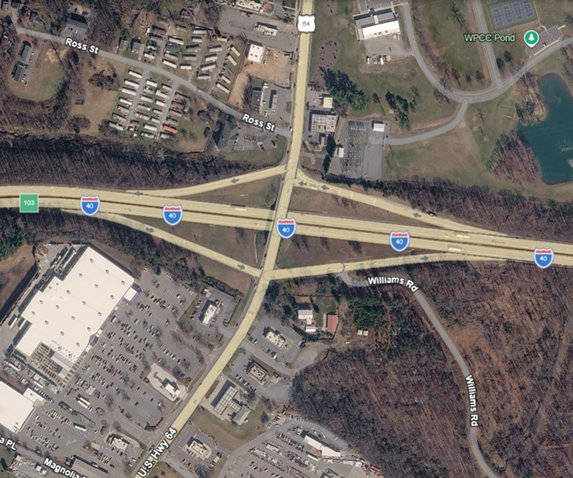
2026 CONGESTION MANAGEMENT PROCESS (CMP) REPORT
Priority #3: US-64 W @ I-40 Exit 103 (Burke)
2026 Score: 29.0 / 50 | 2024 Score: 29.0 | Volume Rank: #4
County: Burke | PTI: 2.50 | TTI: 1.40 | Safety: 42 Crashes | 1.35 Severity Index
OPERATIONAL DIAGNOSTIC
High interchange ramp friction, heavy peak queuing, and elevated crash volume (42 crashes).
RECOMMENDED SHORT-TERM COUNTERMEASURES
Interchange signal retiming & coordination; ramp terminal turn-lane lengthening.
RECOMMENDED LONG-TERM CAPITAL PROGRAM
STIP Project I-5009 interchange reconfiguration; 2055 MTP Long-Range capital project.
[ ATTACH INTERSECTION MAP /
SATELLITE SCREENSHOT HERE ]
GIS Reference Frame — US-64 W @ I-40 Exit 103 (Burke)

Slide 16
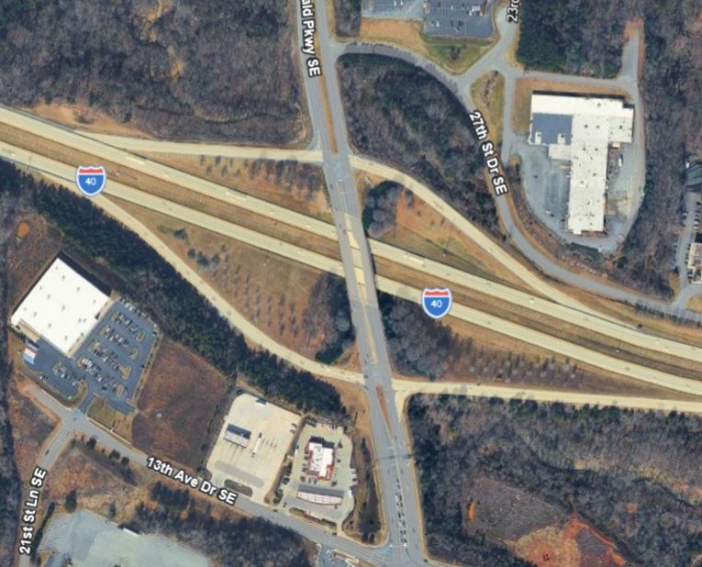
2026 CONGESTION MANAGEMENT PROCESS (CMP) REPORT
Priority #4: McDonald Pkwy S @ I-40 (Catawba)
2026 Score: 27.0 / 50 | 2024 Score: 27.0 | Volume Rank: #1
County: Catawba | PTI: 1.40 | TTI: 1.10 | Safety: 38 Crashes | 5.90 Severity Index
OPERATIONAL DIAGNOSTIC
#1 Regional Bottleneck in Raw Delay Volume; high crash severity index (5.90) due to interchange weaving.
RECOMMENDED SHORT-TERM COUNTERMEASURES
Signal timing coordination across freeway ramp terminals; turn-lane storage expansion.
RECOMMENDED LONG-TERM CAPITAL PROGRAM
Fully funded STIP Project I-5716 (I-40 widening to 6 lanes & interchange reconfiguration).
[ ATTACH INTERSECTION MAP /
SATELLITE SCREENSHOT HERE ]
GIS Reference Frame — McDonald Pkwy S @ I-40 (Catawba)

Slide 17
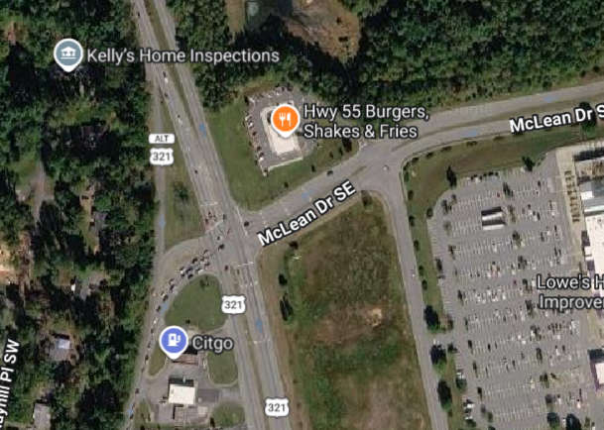
2026 CONGESTION MANAGEMENT PROCESS (CMP) REPORT
Priority #5: US-321-Alt S @ US-321/Hickory Blvd N (Caldwell)
2026 Score: 26.0 / 50 | 2024 Score: 26.0 | Volume Rank: #19
County: Caldwell | PTI: 4.20 | TTI: 3.10 | Safety: 12 Crashes | 2.48 Severity Index
OPERATIONAL DIAGNOSTIC
Regional-high Travel Time Unreliability (PTI 4.20, TTI 3.10); massive peak travel buffer required.
RECOMMENDED SHORT-TERM COUNTERMEASURES
Signal coordination; merge lane lengthening; commercial driveway access management.
RECOMMENDED LONG-TERM CAPITAL PROGRAM
Perform Road Safety Audit (RSA) & Intersection Safety Audit (ISA) for 2055 MTP priority listing.
[ ATTACH INTERSECTION MAP /
SATELLITE SCREENSHOT HERE ]
GIS Reference Frame — US-321-Alt S @ US-321/Hickory Blvd N (Caldwell)

Slide 18
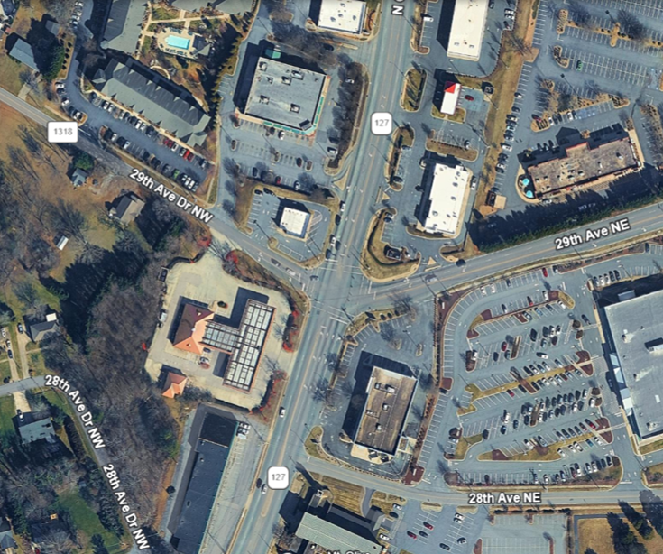
2026 CONGESTION MANAGEMENT PROCESS (CMP) REPORT
Priority #6: 29th Ave Dr NE @ NC-127/N Center St (Catawba)
2026 Score: 25.0 / 50 | 2024 Score: 6.0 | Volume Rank: #26
County: Catawba | PTI: 3.40 | TTI: 1.90 | Safety: 27 Crashes | 2.10 Severity Index
OPERATIONAL DIAGNOSTIC
Top Regional Riser (+19.0 pt surge since 2024) due to dramatic surge in travel unreliability (PTI 3.40).
RECOMMENDED SHORT-TERM COUNTERMEASURES
Signal retiming; intersection widening for dedicated turn lanes; signal phasing optimization.
RECOMMENDED LONG-TERM CAPITAL PROGRAM
Perform Intersection Safety Audit (ISA) & submit for NCDOT P.8 scoring.
[ ATTACH INTERSECTION MAP /
SATELLITE SCREENSHOT HERE ]
GIS Reference Frame — 29th Ave Dr NE @ NC-127/N Center St (Catawba)

Slide 19
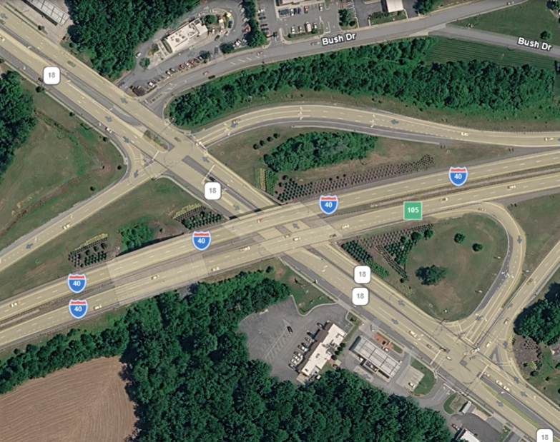
2026 CONGESTION MANAGEMENT PROCESS (CMP) REPORT
Priority #7: NC-18 S @ I-40/Bush Dr (Burke)
2026 Score: 23.0 / 50 | 2024 Score: 25.0 | Volume Rank: #2
County: Burke | PTI: 1.40 | TTI: 1.20 | Safety: 15 Crashes | 1.92 Severity Index
OPERATIONAL DIAGNOSTIC
#2 Regional Bottleneck in Raw Delay Volume; heavy interchange queuing and 4th leg traffic conflicts.
RECOMMENDED SHORT-TERM COUNTERMEASURES
Signal timing coordination; interchange ramp terminal turn-lane extension.
RECOMMENDED LONG-TERM CAPITAL PROGRAM
STIP Project I-5008 (Exit 105 interchange reconfiguration & 4th leg redirect); 2055 MTP.
[ ATTACH INTERSECTION MAP /
SATELLITE SCREENSHOT HERE ]
GIS Reference Frame — NC-18 S @ I-40/Bush Dr (Burke)

Slide 20
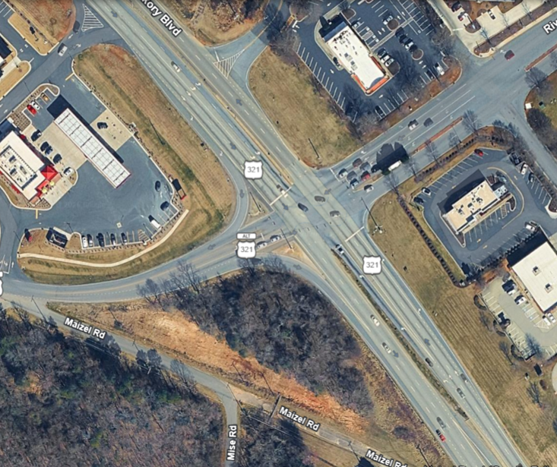
2026 CONGESTION MANAGEMENT PROCESS (CMP) REPORT
Priority #8: US-321 N @ Maizel Rd/New Farm Rd (Caldwell)
2026 Score: 23.0 / 50 | 2024 Score: 25.0 | Volume Rank: #5
County: Caldwell | PTI: 1.40 | TTI: 1.10 | Safety: 47 Crashes (#1 Hotspot) | 2.43 SevIdx
OPERATIONAL DIAGNOSTIC
#1 Regional Crash Hotspot (47 total crashes); severe non-recurring congestion and broadside collision risk.
RECOMMENDED SHORT-TERM COUNTERMEASURES
Signal retiming; warning sign updates; access management control.
RECOMMENDED LONG-TERM CAPITAL PROGRAM
Fully funded STIP Project U-4700CA (Construct Reduced Conflict Intersection / RCI).
[ ATTACH INTERSECTION MAP /
SATELLITE SCREENSHOT HERE ]
GIS Reference Frame — US-321 N @ Maizel Rd/New Farm Rd (Caldwell)

Slide 21
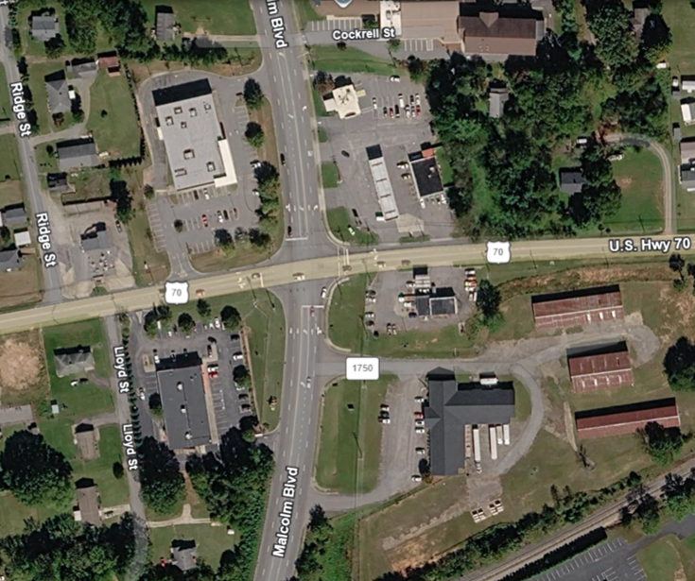
2026 CONGESTION MANAGEMENT PROCESS (CMP) REPORT
Priority #9: US-70 W @ Malcolm Blvd (Burke)
2026 Score: 18.0 / 50 | 2024 Score: 25.0 | Volume Rank: #17
County: Burke | PTI: 1.20 | TTI: 1.10 | Safety: 16 Crashes | 5.23 High Severity Index
OPERATIONAL DIAGNOSTIC
High crash severity index (5.23) driven by high-speed commercial turning movement conflicts.
RECOMMENDED SHORT-TERM COUNTERMEASURES
Signal timing adjustments; driveway consolidation & commercial access control.
RECOMMENDED LONG-TERM CAPITAL PROGRAM
Perform Road Safety Audit (RSA) to evaluate driveway consolidation and RCI feasibility.
[ ATTACH INTERSECTION MAP /
SATELLITE SCREENSHOT HERE ]
GIS Reference Frame — US-70 W @ Malcolm Blvd (Burke)

Slide 22
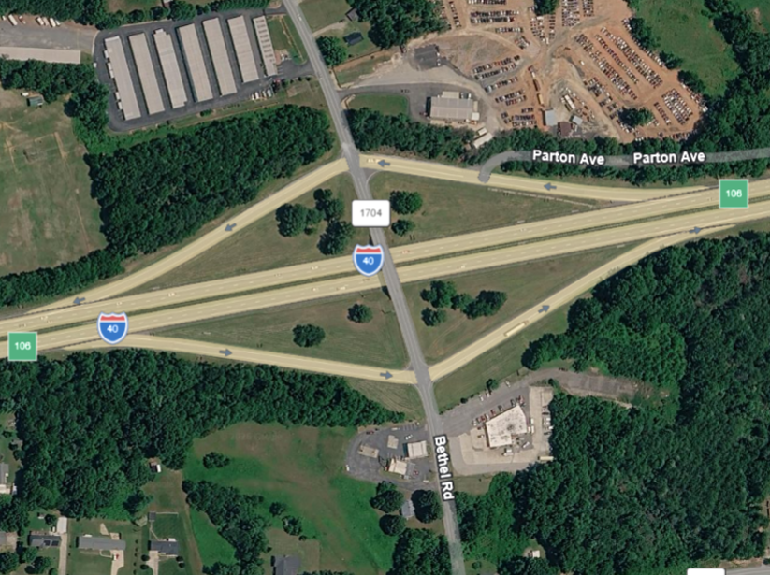
2026 CONGESTION MANAGEMENT PROCESS (CMP) REPORT
Priority #10: I-40 W @ Bethel Rd/Exit 106 (Burke)
2026 Score: 16.0 / 50 | 2024 Score: 22.0 | Volume Rank: #3
County: Burke | PTI: 1.10 | TTI: 1.10 | Safety: 8 Crashes | 2.85 Severity Index
OPERATIONAL DIAGNOSTIC
#3 Regional Bottleneck in Raw Delay Volume; heavy freeway exit ramp queue spillback during peak hours.
RECOMMENDED SHORT-TERM COUNTERMEASURES
Freeway ramp terminal signal coordination; exit ramp turn-lane storage expansion.
RECOMMENDED LONG-TERM CAPITAL PROGRAM
Link to I-40 6-laning corridor study & STIP Project I-5009 interchange program.
[ ATTACH INTERSECTION MAP /
SATELLITE SCREENSHOT HERE ]
GIS Reference Frame — I-40 W @ Bethel Rd/Exit 106 (Burke)

Slide 23
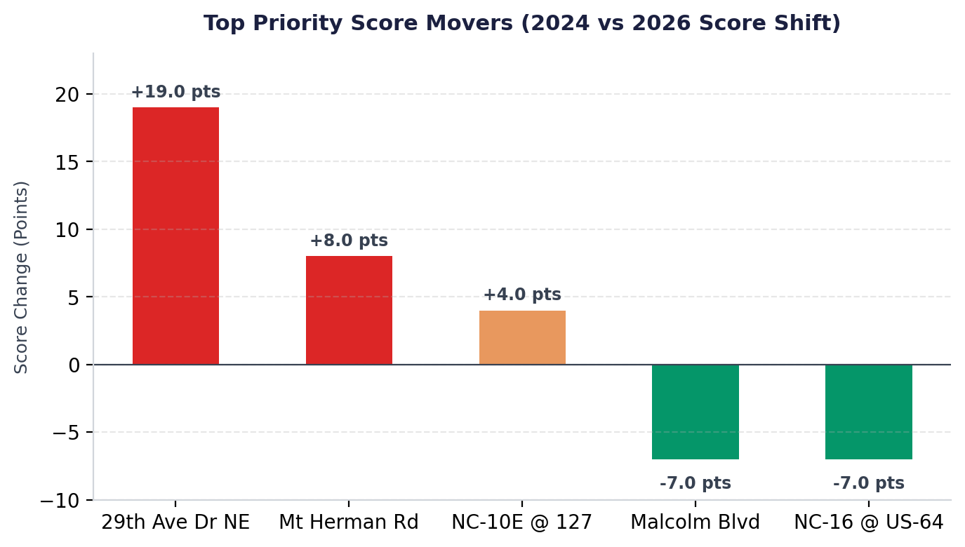
2026 CONGESTION MANAGEMENT PROCESS (CMP) REPORT
2024 vs. 2026 Score Shifts: Top Regional Risers & Improvers
Analysis of Score Dynamics Across 30 Sites:
Top Regional Risers (Increased Priority):
• 29th Ave Dr NE @ NC-127 (+19.0 pts): Surged from 6.0 in 2024 to 25.0 in 2026 due to dramatic increases in peak travel unreliability (PTI 3.40).
• US-321N @ Mt Herman Rd (+8.0 pts): Rose from 6.0 to 14.0 driven by a regional-high 12.71 Severity Index.
• NC-10E @ NC-127 (+4.0 pts): Increased from 6.0 to 10.0.
Top Regional Improvers (Reduced Priority):
• US-70 W @ Malcolm Blvd (-7.0 pts): Improved from 25.0 in 2024 to 18.0 in 2026.
• NC-16 N @ US-64 (-7.0 pts): Improved from 22.0 to 15.0 following localized signal operations adjustments.

Slide 24
2026 CONGESTION MANAGEMENT PROCESS (CMP) REPORT
Transportation Planning Linkage & Scaled Action Matrix
TIER 1: SHORT-TERM OPERATIONAL FIXES
• Traffic Signal Coordination & Retiming across primary arterial corridors.
• Intersection Widening for dedicated turn-lane storage.
• Access Management & Commercial Driveway Consolidation.
TIER 2: FUNDED STIP PROJECTS (8 SITES)
• STIP U-4700CA: US-321 @ Maizel Rd (Construct Reduced Conflict Intersection).
• STIP I-5716: McDonald Pkwy @ I-40 (Widen I-40 to 6 lanes & reconfigure interchange).
• STIP U-5777: NC-150 @ NC-16 (Intersection widening & dual turn lanes).
• STIP I-5009, I-5008, I-5874, I-5971: Interchange reconfiguration programs.
TIER 3: NCDOT P.8 SUBMITTALS & SAFETY AUDITS
• Active P.8 Submittals: Advance unfunded high-priority bottlenecks into P.8 cycle.
• Road Safety Audits (RSA): Conduct RSAs for non-STIP corridors (e.g. US-70 @ Malcolm Blvd).
• Intersection Safety Audits (ISA): Conduct ISAs for rapid risers (e.g. 29th Ave Dr NE).
TIER 4: 2055 MTP LONG-RANGE VISION
• 2055 MTP Integration: Ensure all 30 bottlenecks are mapped into 2055 MTP.
• CTP Corridor Studies: Conduct long-range bypass & freeway interchange studies.
• Multi-Modal Infrastructure: Integrate transit, freight, and active transportation.

Slide 25
Questions & Discussion
2026 Congestion Management Process (CMP) Report
Greater Hickory Metropolitan Planning Organization (GHMPO)

