Slide 1

Final Updates to
National Ambient Air Quality Standards for Ozone
UAQC Meeting
November 17, 2015

Slide 2

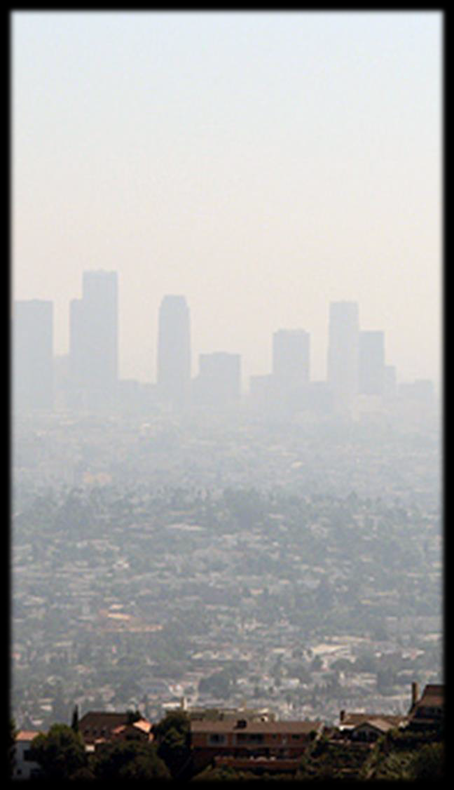
What we’ll cover
Updated standards
Updated Air Quality Index (AQI)
Monitoring updates
Implementation
  PSD permitting
  Upcoming guidance/actions
  Designations
  Ozone transport
2015 Final
8-hour Ozone Standards
Primary: 70 ppb
Secondary: 70 ppb Areas will meet the
standards if the 4th
highest daily maximum 8-
hour ozone concentration per year, averaged over three years, is equal to or less than 70 ppb.
2

Slide 3






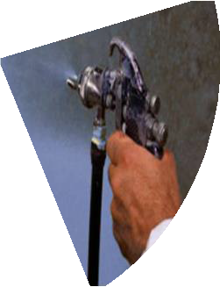

About Ozone
Sources of NOx
Forms in the atmosphere from nitrogen oxides (NOx) and volatile organic compounds (VOCs)
Most commonly elevated in the warm summer months.
But in parts of the western U.S. with high local VOC and NOx emissions, ozone has formed when there is snow on the ground.
Not just a city pollutant: ozone, and the pollutants that form it, can travel long distances on the wind, leading to high ozone even in rural areas.
Industrial/ Commercial/ Residential Fuel Combustion
All other sources
13%
15%
Utilities
63%
Mobile Sources
Sources of VOCs
Petroleum and
related industry
21%
Mobile Sources
39%
Solvent Utilization
22%
18%
Other industrial and commercial processes
3
Source: EPA, 2011 National Emissions Inventory v2 -http://www.epa.gov/ttn/chief/net/2011inventory.html

Slide 4
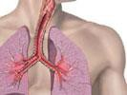
Ozone is Linked
to Serious Health Effects
A large body of scientific evidence shows that ozone:
Causes coughing and sore throat or burning sensation in airways
Reduces lung function, making it harder to breathe deeply
Inflames and damages the airways
Aggravates lung disease, including asthma, emphysema and bronchitis
Increases the frequency and severity of asthma attacks
•
Repeated ozone damage to developing lungs can affect children into adulthood, causing permanent reduction to the lungs’ ability to function, and is likely to be one of the many causes of asthma development.
These effects can lead to:
More medication use for people with asthma
More frequent visits to the doctor
Missed school days
Missed work days
More emergency room visits and hospital admissions
Increased risk of premature death
4

Slide 5

Updates to Primary and Secondary Standards and the Air Quality Index

Slide 6
Updated Standard– Primary
The Clean Air Act charges the EPA Administrator with setting primary standards that are requisite to protect public health with an adequate margin of safety.
In setting the primary ozone standard, the Administrator:
Examined the body of scientific evidence on ozone and health
  Evidence expanded significantly since EPA last reviewed the
ozone standards in 2008.
  Important new studies available since 2008.
    New clinical studies -- provide the most certain evidence of health effects in adults; clearly show ozone at 72 ppb can be harmful to healthy, exercising adults.
    Clinical studies also show effects in some adults following exposures to ozone concentrations as low as 60 ppb; however, there is greater
uncertainty that these effects are adverse.
6

Slide 7
Updated Primary Standard, cont.
The Administrator also reviewed results of analyses of exposure to ozone and looked at how different levels of the standard would reduce risk.
  Analyses take into account how people are exposed to ozone in their
daily lives.
  Focused on risks to children, particularly from repeated exposures.
Administrator also considered advice from the Clean Air Scientific Advisory Committee (CASAC) and public comments on the proposal.
  CASAC concluded that the science supports a standard level within a range of 70 ppb down to 60 ppb, noting that the decision about what standard provides an adequate margin of safety is a judgment left to the Administrator.

Slide 8
Updated Standard – Primary (cont.)
Based on the science, the Administrator has determined that the
2008 standard was not adequate to protect public health.
She revised the standard level to 70 ppb, which:
  Is requisite to protect public health with an adequate margin of safety.
  Is below the lowest exposure level shown to cause adverse health effects in clinical studies.
  Essentially eliminates exposures shown to cause adverse health effects, protecting 99.5 % of children from even single exposures to ozone at 70 ppb.
  Substantially reduces exposures to ozone levels lower than 70 ppb,
reducing multiple exposures to 60 ppb by more than 60%.
    Repeated exposures are important, because the more times children are exposed to ozone, the more likely they will experience serious health effects.

Slide 9
Secondary Standard
EPA also strengthened the secondary (welfare) standard level to 70 ppb to provide requisite public welfare protection from known or anticipated adverse effects.
  New studies add to evidence that repeated exposure to ozone reduces growth and has other harmful effects on plants and trees. These types of effects have the potential to harm ecosystems.
    EPA determined that a standard that generally limits cumulative, seasonal exposures to 17 parts per million-hours or lower, in terms of a three-year W126 index, will provide requisite protection.
      W126 is a cumulative, seasonal index used to measure ozone exposures of concern.
      Analyses of data from air quality monitors show that a standard level of 70 ppb will provide the requisite protection.

Slide 10
AQI Category | Index Values | Breakpoints in the 2008 AQI (ppb, 8-hour average) | Updated Breakpoints (ppb, 8-hour average)
Good | 0-50 | 0-59 | 0-54
Moderate | 51-100 | 60-75 | 55-70
Unhealthy for Sensitive Groups | 101-150 | 76-95 | 71-85
Unhealthy | 151-200 | 96-115 | 86-105
Very Unhealthy | 201-300 | 116-374 | 106-200
Hazardous | 301-500 | 375 to the Significant Harm Level | 201 to the Significant Harm Level
*The Siqnificant Harm Level for ozone is 600ppb... two-hour average
10

Slide 11
Monitoring Updates

Slide 12
Monitoring Updates
Updates to the Photochemical Assessment Monitoring Stations (PAMS)
Extension of ozone monitoring season
Approved additional Federal Reference Method
New data handling provisions for determining compliance with the revised standards

Slide 13
PAMS Network Design Updates
PAMS: multi-pollutant monitoring sites designed to measure ozone, the pollutants that form ozone, and meteorology in order to better understand ozone formation and to evaluate national and local ozone- reduction options.
EPA’s updates will:
  Replace existing 20-year-old multi-site network design with an updated two-part network design.
    Network size will be determined by population size (42 sites).
  Require PAMS measurements to be collocated with existing NCore sites:
    In areas with population of 1 million or more;
    Irrespective of ozone NAAQS attainment status.
  Include a waiver for areas with historically low ozone.

Slide 14
PAMS Network, cont.
States with Moderate or above ozone nonattainment areas will have to develop and implement an Enhanced Monitoring Plan (EMP) to support flexible approaches for collecting data to understand ozone issues in new and existing high ozone areas. States in the Ozone Transport Region also must develop an EMP.
Schedule:
  PAMS monitoring at NCore sites will become effective by June 1, 2019.
  EMPs due within two years of designations or by October 1, 2019, whichever is later.
EPA intends to redistribute available PAMS funding to support the new requirements.

Slide 15
Ozone Monitoring Season
Final rule extends ozone monitoring season for 32 states and D.C.
  One month extension for 22 states and D.C.;
  Additional extensions of two months to seven months for 10 states, including states where ozone can be elevated during the winter;
  Year-round seasons for all NCore multi-pollutant sites.
All waivers are revoked when the rule becomes effective (60 days after
publication in the Federal Register)
  Regions and states with existing waivers should pursue new waivers as appropriate.
  Regional Administrators will still be allowed to approve changes to states’ ozone
monitoring seasons without rulemaking.
Does not affect the CSAPR trading program ozone season (remains May 1 – Sept 1).

Slide 16
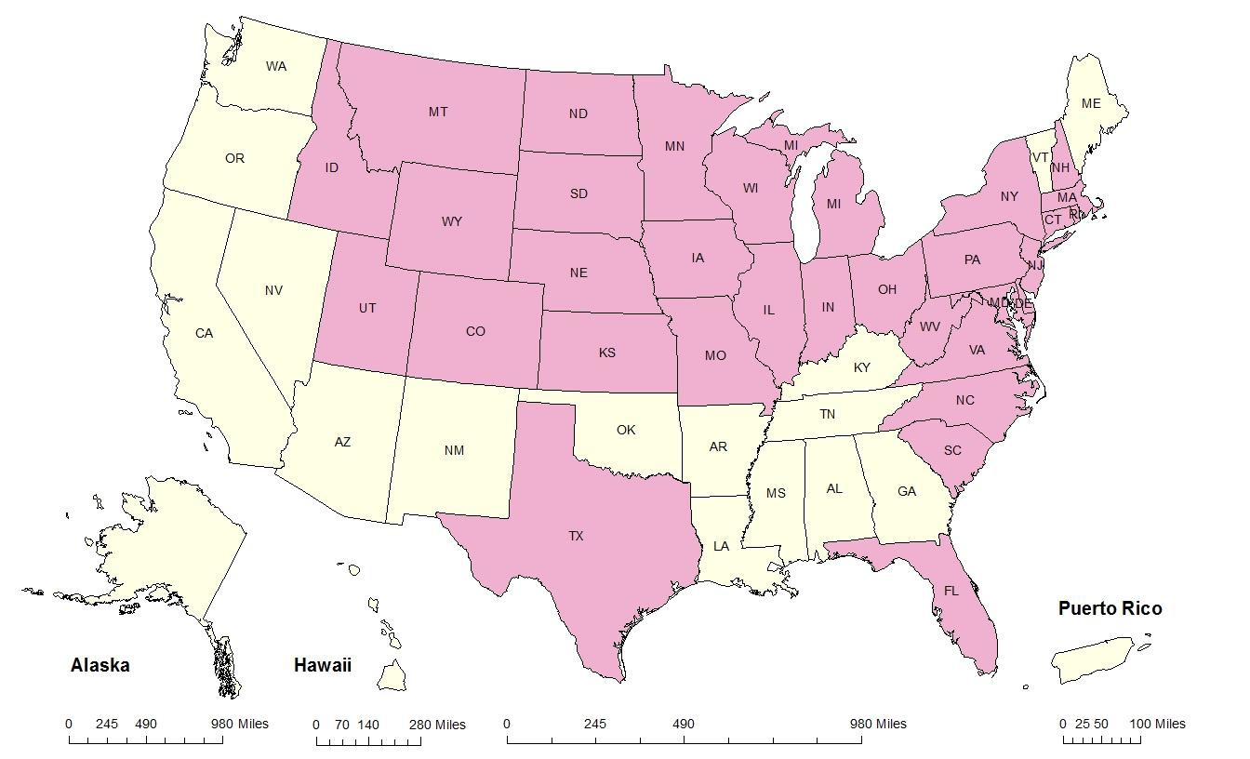
Ozone Monitoring Seasons
Effective January 1, 2017
5-9
4-9
4-9
3-9
4-9
5-9
3-10
3-9
NH RI MA CT
4-9
3-10
3-
10/15
3-10
1-9
3-10
3-10
3-10
3-10
3-10
1-12
3-10
3-10
3-10
NJ DE MD DC
1-12
3-10
3-10
1-12
1-12
3-10
3-10
3-10
3-10
3-10
1-12
1-12
3-11
3-11
3-10
3-11
3-10
3-10
Season Change No Change
3-10
3-10
4-10
1-12
1-12
1-12
1-12
1-12
1
6

Slide 17
Other monitoring updates
Federal Reference Method (FRM)
Updated FRM for ozone includes an additional method that is based
on advanced technology and monitoring methods.
States are not required to replace their existing ozone monitors.
Current FRM and Federal Equivalent ozone monitors will continue to meet EPA requirements.
Data Handling Requirements
EPA issued a new appendix addressing data handling provisions for determining compliance with the updated standards
17

Slide 18
Implementation

Slide 19
Meeting the Standards
Existing and proposed federal rules will help states meet the standards by reducing ozone-forming pollution. These rules include:
Regional Haze regulations;
Mercury and Air Toxics Standards;
Clean Power Plan;
Tier 3 Vehicle Emissions and Fuels Standards;
Light-Duty Vehicle Tier 2 Rule;
Mobile Source Air Toxics Rule;
Light-Duty Greenhouse Gas/Corporate Average Fuel Efficiency Standards;
Heavy-Duty Vehicle Greenhouse Gas Rule;
Reciprocating Internal Combustion Engines (RICE) NESHAP;
Industrial/Commercial/Institutional Boilers and Process Heaters MACT
(and amendments); and
Requirements to reduce the interstate transport of air pollution.

Slide 20
Implementation Updates
Implementation memo
PSD permitting
Current and upcoming rules and guidance
Ozone from background sources
Designations schedule
Ozone implementation rule
Attainment plan deadlines and attainment dates

Slide 21
Memo from Acting Assistant
Administrator
EPA will work with state, tribal, local and federal agencies to implement the updated standards in a way that maximizes common sense, flexibility and cost-effectiveness, while following the requirements of the Clean Air Act.
Memo issued with the revised standards outlines the agency’s plans for addressing issues related to:
  Guidance available to agencies;
  Ensuring major source permitting is effective and efficient;
  Designating areas;
  Background ozone;
  Interstate ozone transport;
  The challenges of reducing ozone in California;
  Managing monitoring networks;
  Emissions from wildland fires; and
  Transportation planning.
Memo available at: http://go.usa.gov/3SRhR
21

Slide 22
PSD Permitting Updates
Rule includes grandfathering provision to avoid delay of certain pending applications. Permit can be issued under terms of compliance with the 2008 ozone NAAQS if either:
  The permitting agency has formally determined the application to be complete as of Oct. 1, 2015; or
  The public notice for a draft permit or preliminary determination has been published prior to the date revised ozone standards become effective (60 days after publication in the Federal Register).
Compliance demonstration tools (MERPs, SILs)
PSD offsets
Update to 40 CFR Appendix W to Part 51 (Guideline on Air Quality Models)

Slide 23
Implementation-Related
Rules & Guidance
Current and draft guidance that will apply to the updated
standards:
  Guidance on Infrastructure State Implementation Plan (SIP) Elements under CAA Sections 110(a)(1) and 110(a)(2) − September 13, 2013 (http://www.epa.gov/airquality/urbanair/sipstatus/infrastructure.html)
  Draft Emissions Inventory Guidance for Implementation of Ozone [Particulate Matter] National Ambient Air Quality Standards (NAAQS) and Regional Haze Regulations – April 2014 (http://www3.epa.gov/ttn/chief/eidocs/eiguid/index.html)
  Draft Modeling Guidance for Demonstrating Attainment of Air Quality Goals for Ozone, PM_{2.5}, and Regional Haze – December 2014 and Guidance on the Use of Models and Other Analyses for Demonstrating Attainment of Air Quality Goals for Ozone, PM_{2.5}, and Regional Haze – April 2007 (http://www.epa.gov/scram001/guidance_sip.htm)

Slide 24
Implementation-Related Rules & Guidance, cont.
Current rules that apply to the revised NAAQS:
  Revisions to the General Conformity Regulations (75 FR 17254, April 5, 2010) and guidance (40 CFR part 93, subpart B and 40 CFR part 51, subpart W) (http://www3.epa.gov/airquality/genconform/regs.html)
  Transportation Conformity Rule (77 FR 14979, March 14, 2012) and Guidance for Transportation Conformity Implementation in Multi-Jurisdictional Nonattainment and Maintenance Areas – February 2012 (40 CFR part 93, subpart A and 40 CFR part 51, subpart T) (http://www3.epa.gov/otaq/stateresources/transconf/index.htm)

Slide 25
Upcoming Implementation-Related
Rules/Guidance/Activities
Area designations guidance (including rural transport areas)
Nonattainment area classifications and attainment dates rule
Updates to nonattainment area SIP requirements rule, including possible anti-backsliding provisions for 2008 NAAQS
Nationwide interstate transport contribution assessment
Updates to transportation conformity guidance
White paper and workshop on background ozone issues

Slide 26
Ozone from Background Sources
Background ozone refers to ozone that forms from natural sources, such as wildfires or stratospheric intrusions, and from man-made pollution from sources outside the U.S.
EPA is planning for further discussions with stakeholders on assessing areas for high background ozone and on applicable policies and tools.
Relevant Clean Air Act provisions
  Exceptional event exclusions
  Area designations and rural transport areas
  Section 179B international emissions

Slide 27
Designations Schedule
By February 2016: EPA issues area designations guidance
By October 1 2016: States’ (and any tribes that choose to do so) recommendations due
By June 1, 2017: EPA responds to states’ and tribes’ initial recommendations and identifies where the agency intends to modify the recommendations.
  States and tribes will have the opportunity to comment on EPA’s response and
to provide new information and analyses for EPA to consider.
By October 1, 2017: EPA issues final area designations; those designations likely would be based on 2014-2016 air quality data.
  Early-certified 2017 data may also be relevant to final designations.
  Exceptional event demonstration submission deadlines:
    October 1, 2016 for 2014-2015 events
    May 31, 2017 for 2016 events
    May 31, 2018 for 2017 events

Slide 28
Hickory MSA Ozone Monitor Readings
Fourth Highest 8-Hour Ozone 3-year Averages (or Design Values) (parts per billion), 2005-2015
Monitor | 2005-07 | 2006-08 | 2007-09 | 2008-10 | 2009-11 | 2005-07 | 2011-13 | 2012-14 | 2013-15*
Alexander County Taylorsville | 79 | 77 | 73 | 70 | 67 | 68 | 65 | 64 | 64
Caldwell County Lenoir | 76 | 75 | 71 | 69 | 67 | 67 | 64 | 62 | 62
*2015 data is preliminary and not been varied by USEPA. Source: USEPA and NC Division of Air Quality, 2015.
2013-2015 3-Year Ozone Average are below the new standard at all monitor sites in North Carolina.

Slide 29
Ozone Implementation Rule
Would cover any nonattainment area classification thresholds and any necessary updates to the 2008 Ozone NAAQS State Implementation Plan Requirements Rule.
Update the SIP due dates for emissions inventories, RACT, attainment plans/demos, RFP plans, contingency measure plans, section 185 programs.
Address ongoing implementation for 2008 NAAQS, including revoking the 2008 NAAQS and anti-backsliding provisions.

Slide 30
SIP Deadlines and Attainment Dates
2020 to 2021: Attainment plans and demonstrations due for nonattainment areas classified as “Moderate” and above.
2020 to 2037: Nonattainment areas are required to meet the primary (health) standard, with deadlines depending on the severity of an area’s ozone problem.
Attainment Schedule by Classification
Classification | Schedule to Attain
Marginal | 3 years from date of designation
Moderate | 6 years
Serious | 9 years
Severe | 15 to 17 years
Extreme | 20 years
*Areas must attain as expeditiously as practical, but not later than the schedule in the table. Two one-year extensions are available in certain circumstances based on air quality.

Slide 31
Ozone Transport

Slide 32
Ozone Transport – 2008 Standards
Many states still do not have approved transport SIPs for the
2008 Ozone NAAQS.
With the Supreme Court ruling and subsequent Circuit Court rulings on CSAPR, EPA plans to move forward on transport using the CSAPR framework, updated for the 2008 NAAQS:
  Planning to propose a “backstop” FIP rule for states in the East this fall, with a focus on near-term EGU measures that can be in place by 2017 (for Moderate area attainment deadline).
  A NODA for 2011 and 2017 emissions data along with the air quality contribution modeling to be used in the proposal was published on July 23, 2015. Comment period closes October 23, 2015.
EPA recognizes this proposal will focus on the eastern U.S. and is working with western states to determine SIP requirements for states outside the rulemaking.

Slide 33
Ozone Transport – 2015 Standards
Having the CSAPR framework established and in place will help us make progress on transport issues for the 2015 ozone NAAQS.
Transport SIPs are a state obligation; however, EPA can assist states with some of the technical analyses related to transport.
EPA is planning to do source apportionment modeling to provide contribution information for the 2015 NAAQS to help states begin developing their 110 SIPs (due October 2018).
  Intend to make this information available in Fall 2016.

Slide 34
For additional information
To read the final rule and fact sheets, visit
http://www3.epa.gov/ozonepollution/actions.html
For technical documents related to the review of the
standard, see: http://www.epa.gov/ttn/naaqs/standards/ozone/s_o3_in dex.html
For local air quality forecasts and information on current
air quality, visit www.airnow.gov

