Slide 1
NATIONAL AMBIENT AIR QUALITY
STANDARDS FOR FINE PARTICULATE MATTER (PM 2.5) – FINAL RULE
DECEMBER 14, 2012

Slide 2
OVERVIEW OF EPA’S REVISIONS TO THE AIR QUALITY STANDARDS FOR PARTICLE POLLUTION (FINE PARTICULATE MATTER)
An extensive body of scientific evidence shows that long- and short-term exposures to fine particle pollution, also known as fine particulate matter (PM2.5), can cause premature death and harmful effects on the cardiovascular system, including increased hospital admissions and emergency department visits for heart attacks and strokes. Scientific evidence also links PM to harmful respiratory effects, including asthma attacks.
People most at risk from particle pollution exposure include people with heart or lung disease (including asthma), older adults, children and people of lower socioeconomic status. Research indicates that pregnant women, newborns and people with certain health conditions, such as obesity or diabetes, also may be more susceptible to PM-related effects.
Particle pollution also causes haze in cities and some of our nation’s most treasured national parks.

Slide 3
OVERVIEW OF EPA’S REVISIONS TO THE AIR QUALITY STANDARDS FOR PARTICLE POLLUTION (FINE PARTICULATE MATTER)
EPA examined thousands of studies as part of this review of the standards, including hundreds of new studies published since EPA completed the last review of the standards in 2006. The new evidence includes more than 300 new epidemiological studies, many of which report adverse health effects even in areas that meet the current PM2.5 standards. EPA also considered analyses by agency experts, along with advice from the Clean Air Scientific Advisory Committee and public comments.
As part of EPA’s commitment to a transparent, open government, the agency sought and received broad public input in setting this standard that provides critical health protection to tens of millions of Americans. EPA held two public hearings on the proposed standards, and received more than 230,000 written comments.
The Clean Air Act requires EPA to review the particle pollution standards every five years. The revisions, which are a result of that review, also respond to a court remand of portions of the agency’s 2006 decision on the PM2.5 standards.

Slide 4
OVERVIEW OF EPA’S REVISIONS TO THE AIR QUALITY STANDARDS FOR PARTICLE POLLUTION (FINE PARTICULATE MATTER)
For fine particles, EPA is:
o Strengthening the annual health standard (primary standard) for PM2.5 by setting the standard at 12.0 μg/m3. The existing annual standard, 15.0 μg/m3, was set in 1997.
o Retaining the existing 24-hour health standard (primary standard) for PM2.5, at 35 μg/m3. EPA issued the 24-hour standard in 2006.
o Retaining the existing secondary standards for PM2.5 to address PM-related effects such as visibility impairment, ecological effects, damage to materials and climate impacts. This includes an annual standard of 15.0 μg/m3 and a 24-hour standard of 35 μg/m3. The agency is relying on the existing secondary 24-hour PM2.5 standard to protect against visibility impairment, and is not finalizing the separate standard to protect visibility the EPA proposed in June 2012.
EPA had proposed to set a separate secondary 24-hour standard to provide protection against PM-related visibility effects; however, after considering public comment on the proposal and further analyzing recent air quality monitoring data, the agency has concluded that the current secondary 24-hour PM2.5 standard of 35μg/m3 will provide visibility protection that is equal to, or greater than, 30 deciviews, the target level of protection the agency is setting today. (A deciview is a yardstick for measuring visibility.)

Slide 5
OVERVIEW OF EPA’S REVISIONS TO THE AIR QUALITY STANDARDS FOR PARTICLE POLLUTION (FINE PARTICULATE MATTER)
More details about EPA’s action:
The rule also addresses several issues related to implementation of the revised standards. Among them:
o The agency is making updates and improvements to the nation’s PM2.5 monitoring network that include relocating a small number of monitors to measure fine particles near heavily traveled roads in areas with populations of 1 million or more. These relocations will be phased in over two years (2015-2017) and will not require additional monitors.
o In addition, EPA is updating the Air Quality Index (AQI) for PM2.5 to be consistent with the final health standards.
o EPA anticipates making initial attainment/nonattainment designations by December 2014, with those designations likely becoming effective in early 2015.
o EPA estimates that meeting the annual primary fine particle standard of 12.0 μg/m3 will provide health benefits worth an estimated $4 billion to $9.1 billion per year in 2020 -- a return of $12 to $171 for every dollar invested in pollution reduction. Estimated annual costs of implementing the standard are $53 million to $350 million.

Slide 6
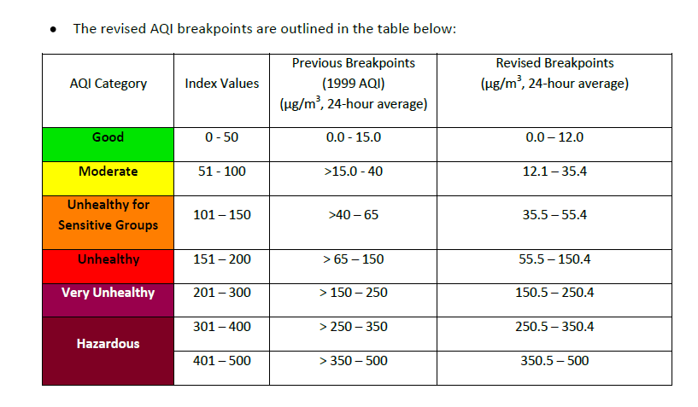
REVISED AIR QUALITY STANDARDS FOR PARTICLE POLLUTION AND UPDATES TO THE AIR QUALITY INDEX (AQI)

Slide 7
CURRENT AND PROJECTED PM 2.5 MONITOR DATA FROM EPA

Slide 8
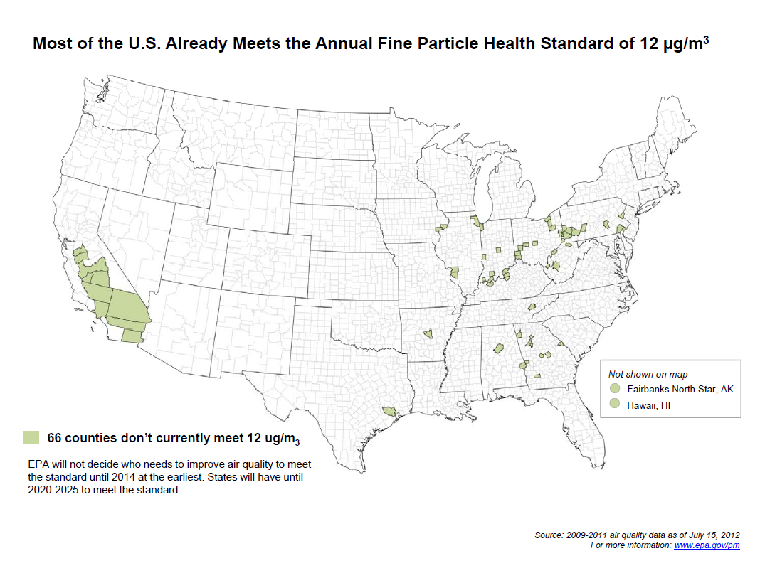

Slide 9
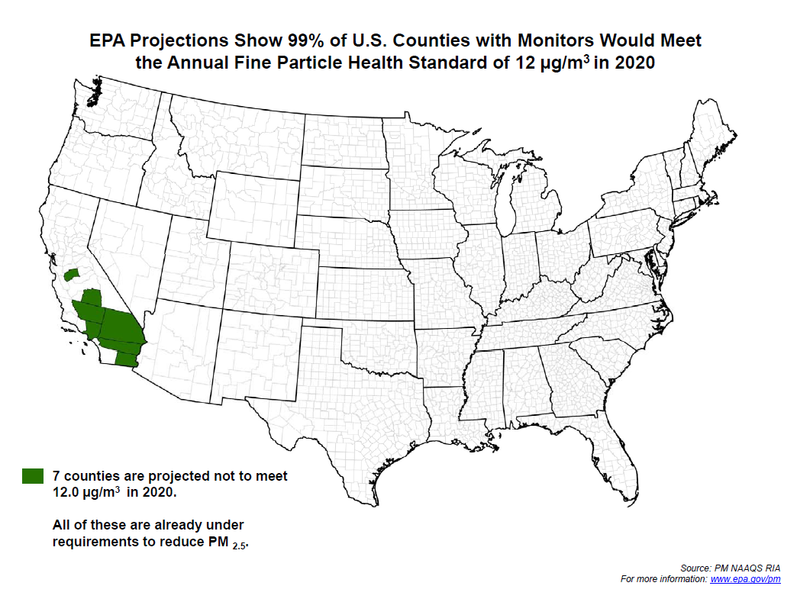

Slide 10
State County 2009-2011 Annual Design Value (μg/m3)
North Carolina Alamance 10.1
North Carolina Buncombe 9.3
North Carolina Caswell 8.9
North Carolina Catawba 10.6
North Carolina Chatham 8.5
North Carolina Cumberland 10.3
North Carolina Davidson 11.1
North Carolina Duplin 8.9
North Carolina Durham 9.7
North Carolina Edgecombe 9.1
North Carolina Forsyth 10.0
North Carolina Gaston 10.5
North Carolina Guilford 9.8
North Carolina Haywood 10.0
North Carolina Jackson 9.4
North Carolina Johnston 9.2
North Carolina Lenoir 9.3
North Carolina Martin 8.7
North Carolina McDowell 9.8
North Carolina Mecklenburg 11.2
North Carolina Mitchell 9.3
North Carolina Montgomery 9.3
North Carolina Pitt 8.7
North Carolina Robeson 10.0
North Carolina Rowan 10.5
North Carolina Swain 9.7
North Carolina Wake 9.8
North Carolina Watauga 8.3
North Carolina Wayne 9.9

Slide 11
State County 2020 Projected Annual Design Value (μg/m3)
North Carolina Alamance 7.5
North Carolina Buncombe 7.0
North Carolina Caswell 6.9
North Carolina Catawba 8.7
North Carolina Chatham 6.7
North Carolina Cumberland 8.1
North Carolina Davidson 8.7
North Carolina Duplin 6.3
North Carolina Durham 8.4
North Carolina Edgecombe 7.2
North Carolina Forsyth 7.7
North Carolina Gaston 8.0
North Carolina Guilford 6.4
North Carolina Haywood 9.1
North Carolina Jackson 7.6
North Carolina Lenoir 6.3
North Carolina Martin 6.4
North Carolina McDowell 8.5
North Carolina Mecklenburg 8.4
North Carolina Mitchell 7.7
North Carolina Montgomery 7.1
North Carolina New Hanover 5.9
North Carolina Onslow 6.4
North Carolina Orange 7.7
North Carolina Pitt 7.0
North Carolina Robeson 7.8
North Carolina Rowan 8.3
North Carolina Swain 7.9
North Carolina Wake 7.8
North Carolina Watauga 6.3
North Carolina Wayne 7.7

